Slide 1
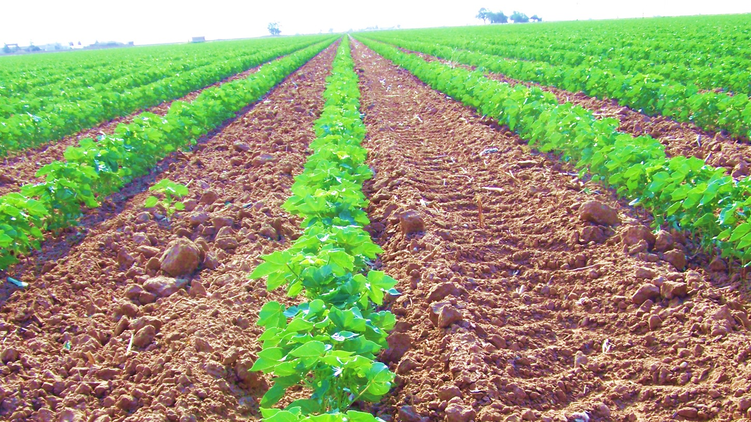
Warming impacts on soil carbon dynamics and crop yield in irrigated and dryland cotton.
Pawan Devkota
MS Biology
(van Gestel Lab)

Slide 2
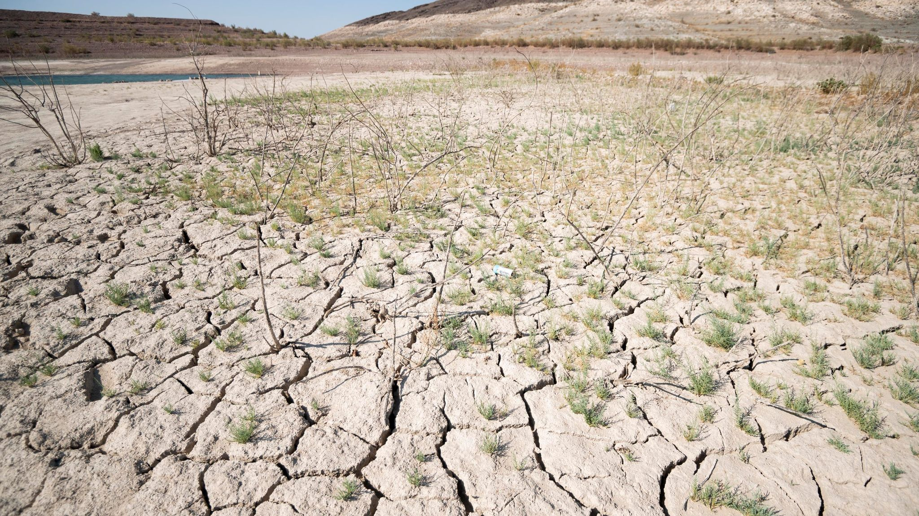
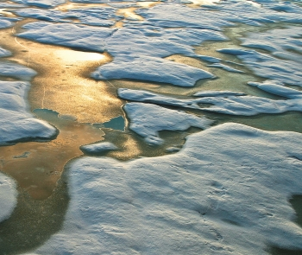

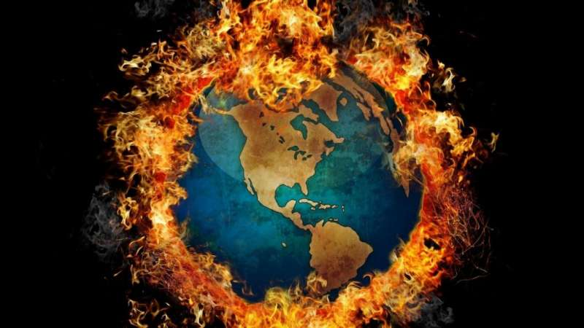
Climate Change

Slide 3
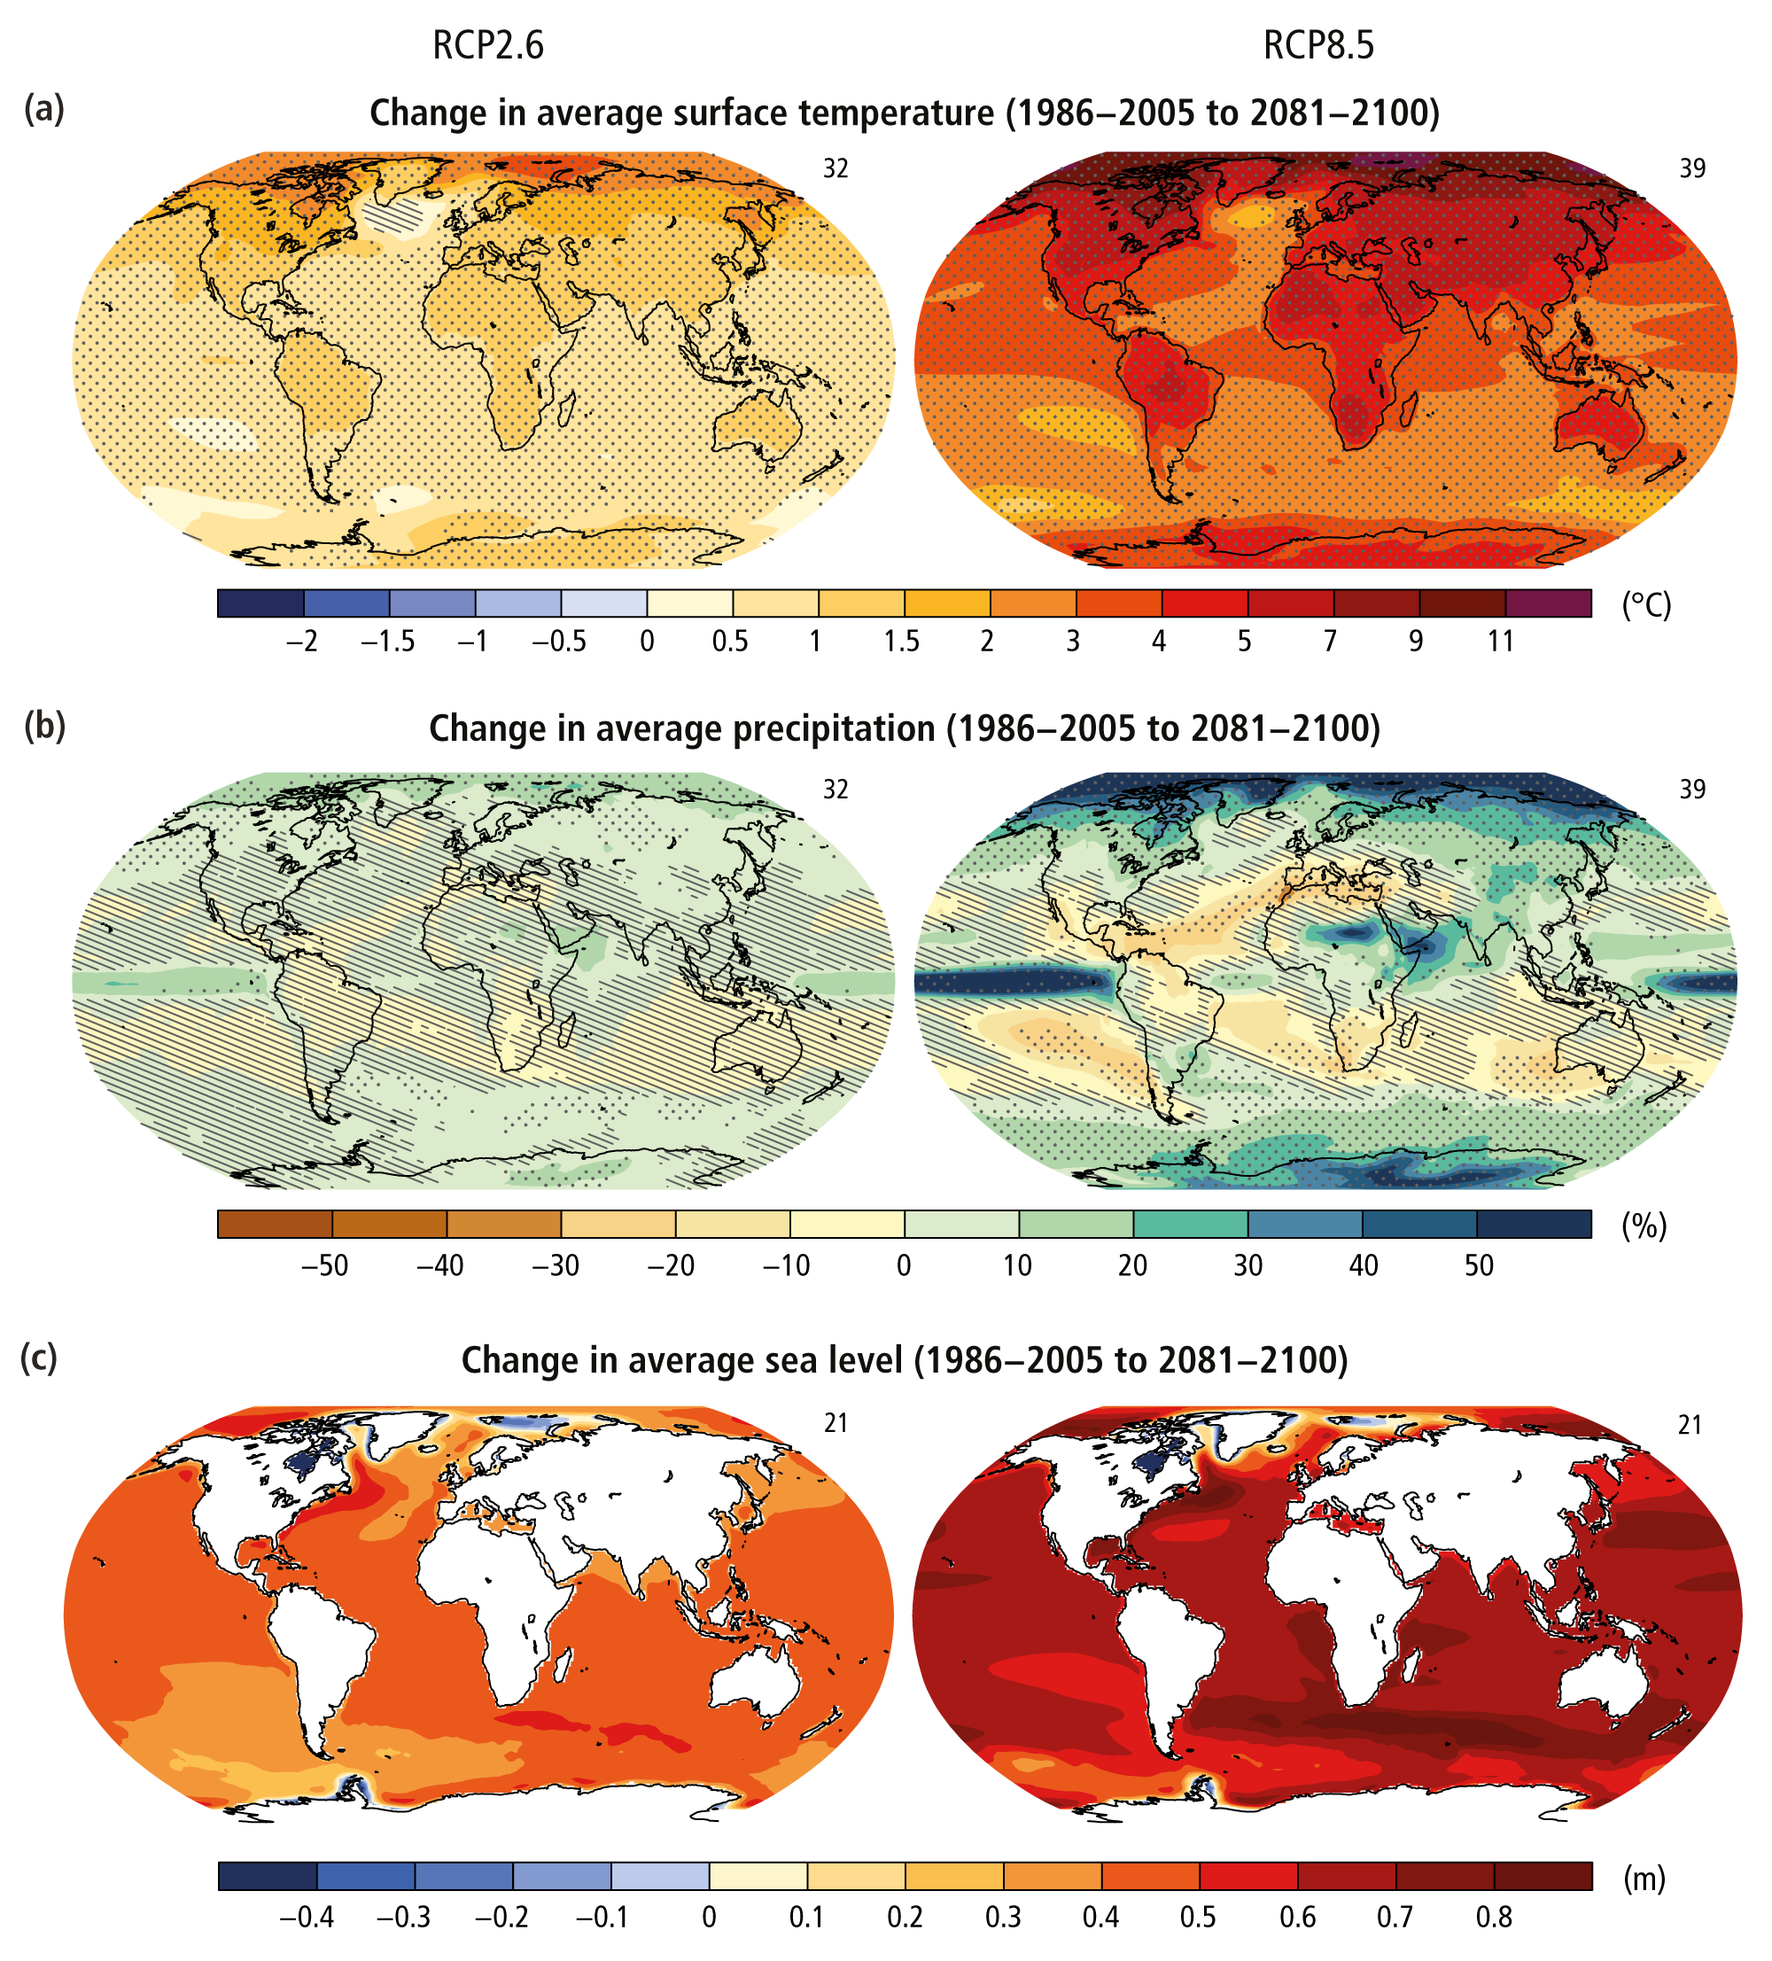
Global warming
Global temperature in 2011-2020 was 1.09 ºC higher than 1850-1900.
Projection: will rise by 1.5ºC to 2ºC by the end of 21st century
Change in Precipitation
Source: IPCC

Slide 4
Climate change and Agriculture
Extreme events: Drought, Floods, Windstorms
Desertification
Biodiversity loss
Land and water resource degradation
Disrupt biogeochemical cycles

Slide 5

Chapter 1 Warming accelerates carbon loss in the soil by enhancing soil respiration

Slide 6
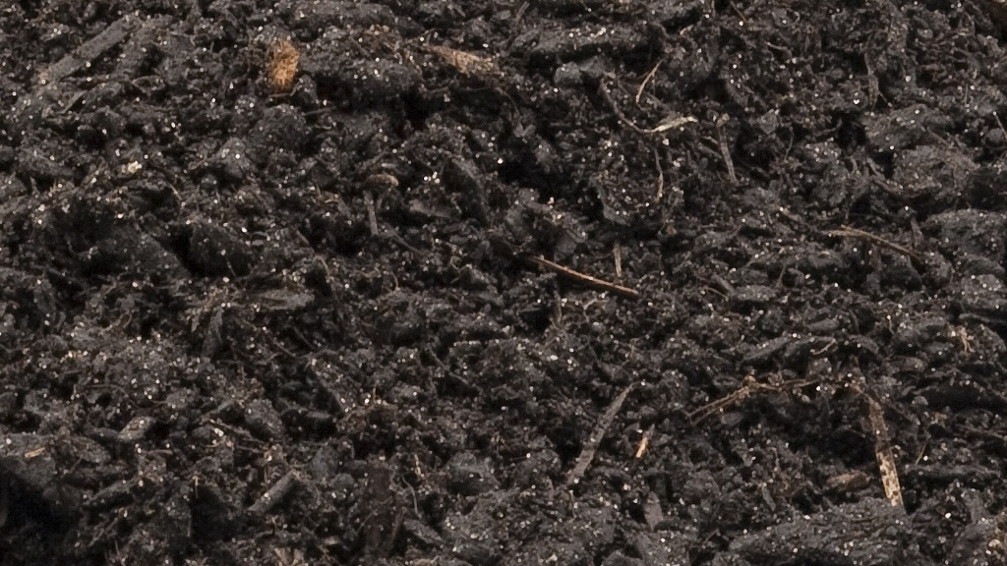
Soil Organic Carbon (SOC)
Soil is a greatest reservoir of terrestrial carbon
SOC : 62% of terrestrial carbon (Lal, 2004)
Major Source: Soil organic matter (SOM) - (58% organic carbon)
Soil carbon Pools:
Labile
recalcitrant

Slide 7
Importance of SOC
Improve soil health
Improves nutrient retention, availability, and plant growth
Soil structure/aggregation
Water retention
Enhance biological activity

Slide 8
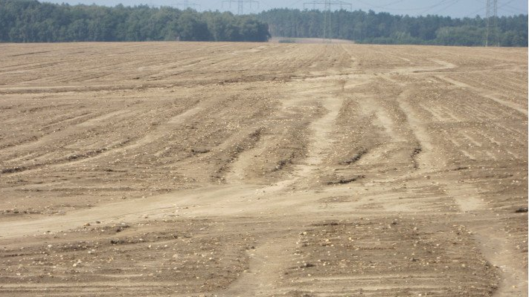
SOC content is declining
Decomposition
Soil respiration
Carbon Mineralization

Slide 9
Temperature and moisture dependency
Mean annual precipitation (MAP) accounted for 81.8 percent and 13.8 percent of the variance in SOC chemical and physical fractionation, respectively, whereas mean annual temperature (MAT) contributed 1.5 percent and 34.7 percent, respectively (Zeng et al., 2021)
Warming enhance soil respiration, plant growth, organic matter decomposition, and nutrient mineralization (Rustad et al, 2001)
Warming:
increase evapotranspiration – decrease soil moisture lower – SOC decomposition rate (Lie et al, 2009)
lower MBC and microbial respiration when soil moisture was a limiting factor (Liu et al., 2016)
Wang et al (2014), in a meta-analysis, noticed that warming-induced soil moisture reductions, which were especially visible in dry areas, attenuated or even eliminated the stimulation of soil respiration by warming

Slide 10
Climate Change
Warming
Change in precipitation
Increased CO2 concentration
Soil Moisture
CO2
Soil microbial activity
Net primary production (NPP)
SOM
Soil respiration

Slide 11
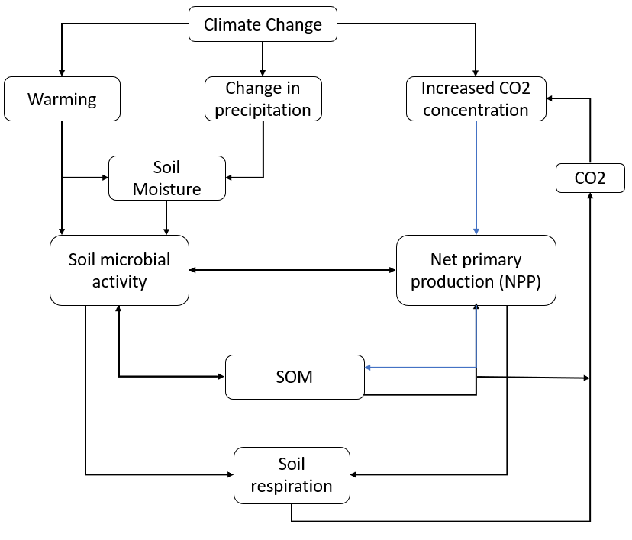
Climate-Carbon Feedback

Slide 12
Overcoming carbon loss
Carbon sequestration
Conservation agricultural practices
Minimum/no tillage
Crop rotation
Cover crop
Residue management

Slide 13
Objectives
to investigate the effects of warming on soil organic matter, microbial biomass carbon, and soil respiration
to study how irrigation and residue application changes the warming impacts.

Slide 14
Warming
Irrigated
Dryland
Residue
No residue
Residue
No residue
MBC
MBC
Soil respiration
Soil respiration
SOC
SOC

Slide 15
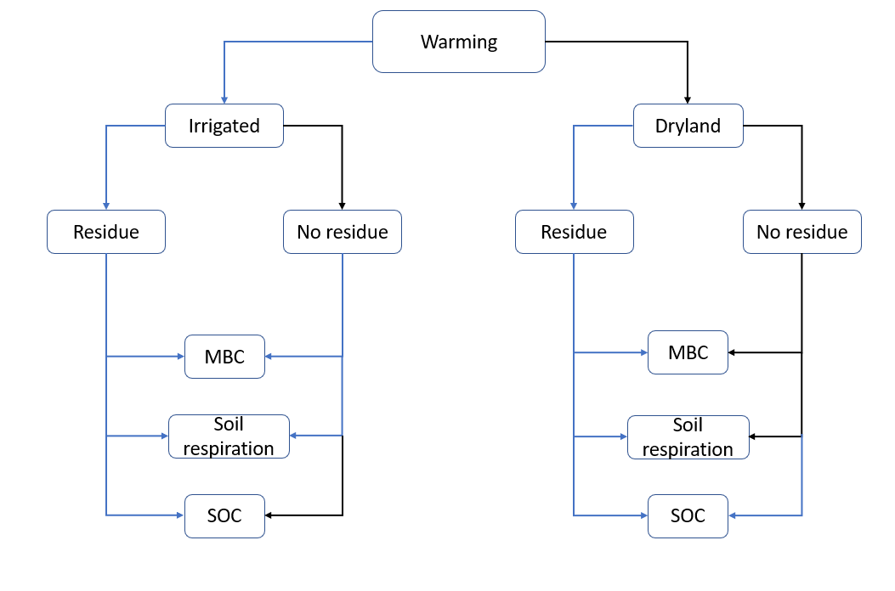
Hypothesis

Slide 16
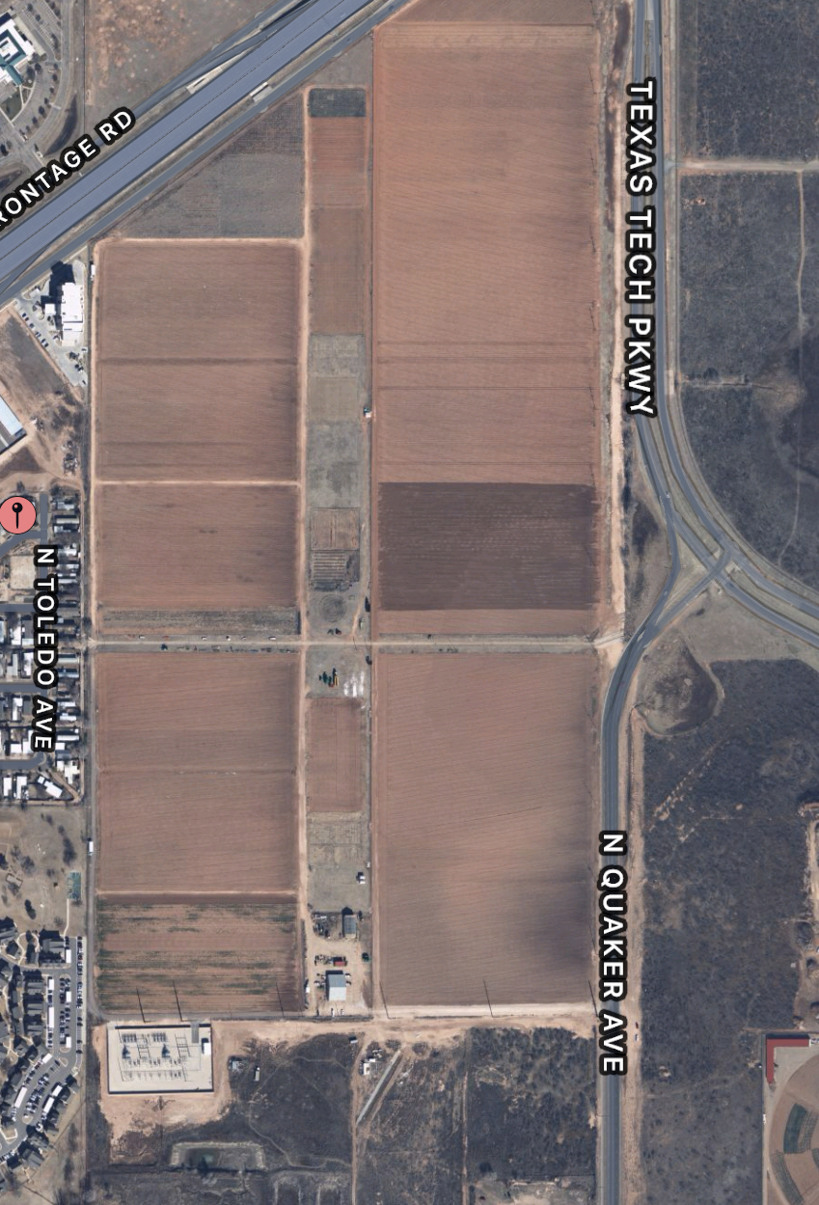
Site characteristics
Location: Quaker Research Farm, Lubbock (33° 41’ 36.45” N, -101° 54’ 18.61 “W, 992.43m a.s.l.)
MAP: 473 mm; MAT: 15.92 °C (maximum monthly mean: 33.89 °C in July, minimum monthly mean: -3.33 °C in January)
Average temp and precipitation in growing season of 2021??

Slide 17
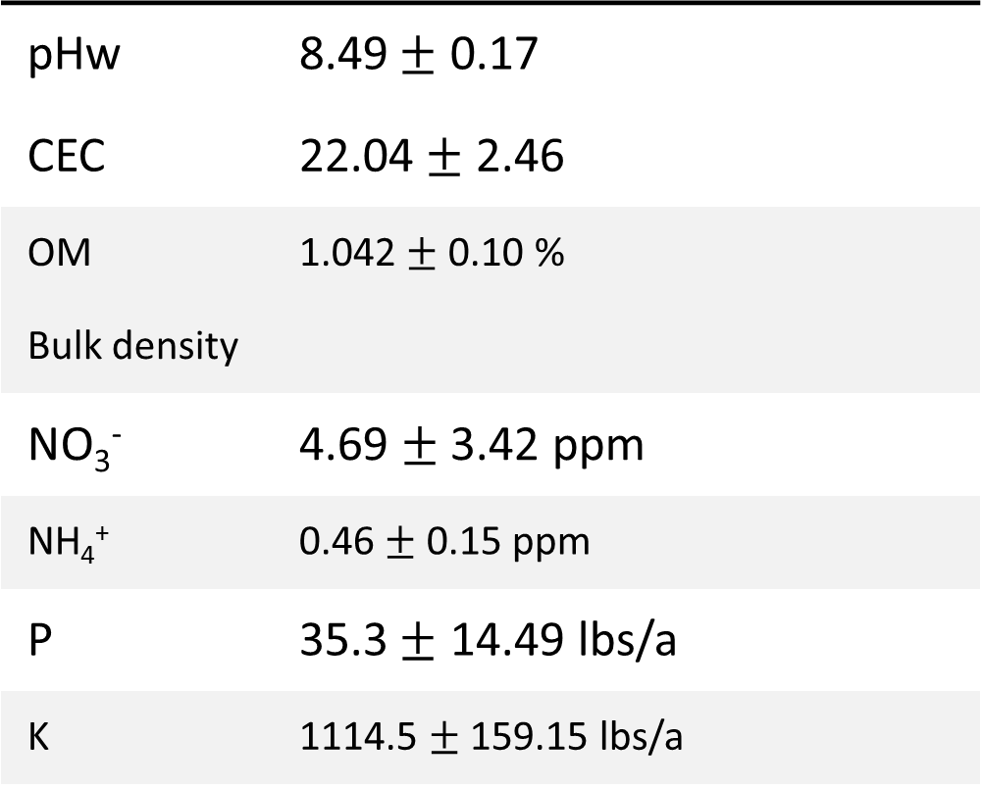
Soil characteristics
pHw | 8.49$±$ 0.17
CEC | 22.04$±$ 2.46
OM | 1.042 $±$ 0.10 %
Bulk density
NO₃⁻ | 4.69 $±$ 3.42 ppm
NH₄⁺ | 0.46 $±$ 0.15 ppm
P | 35.3$±$ 14.49 lbs/a
K | 1114.5 $±$ 159.15 lbs/a

Slide 18
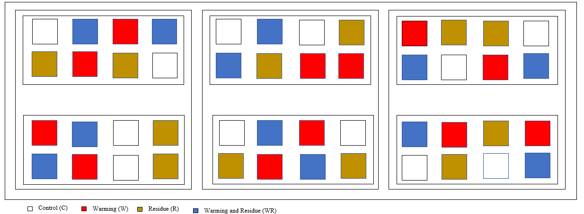
Experimental Design
Nested Design
Treatments
Warming (Ambient, Warming)
Residue (Residue, No-residue)
Irrigation (Irrigated , Dryland)

Slide 19
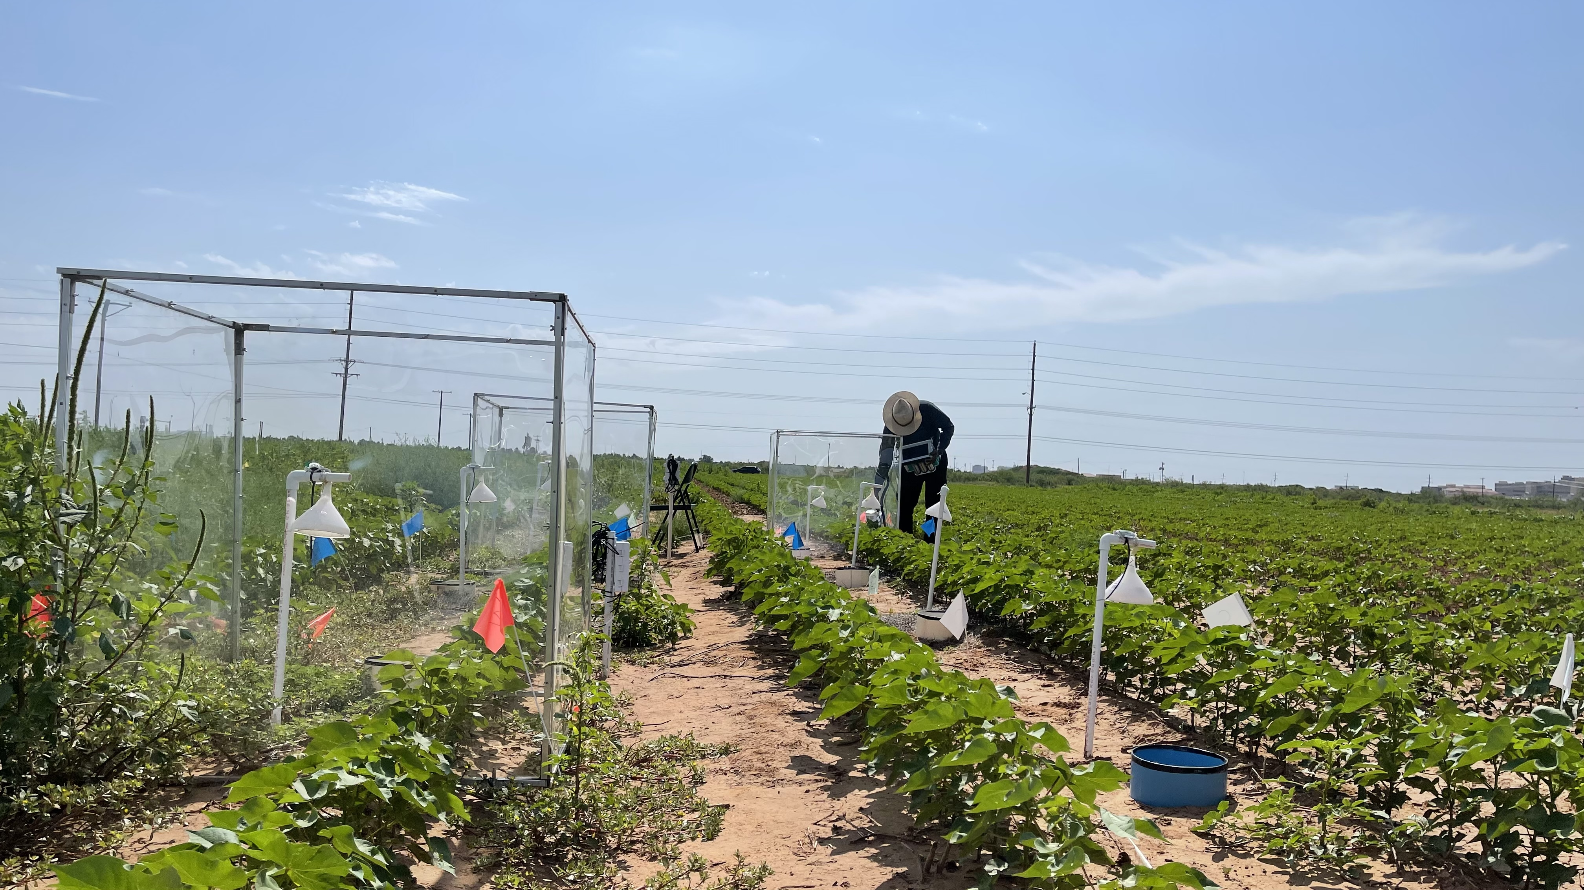
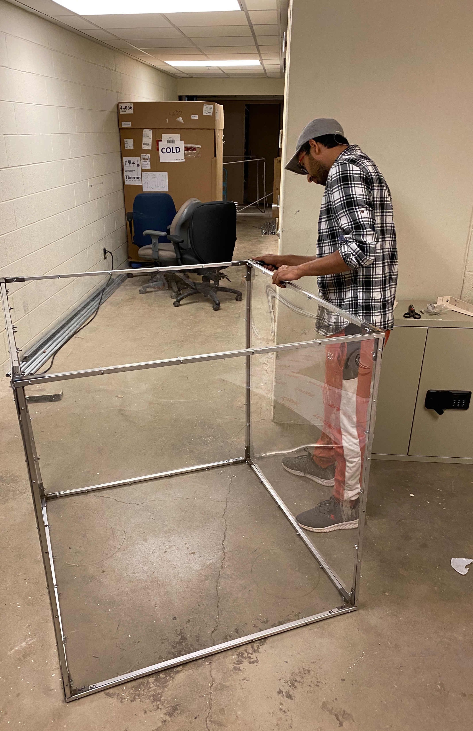
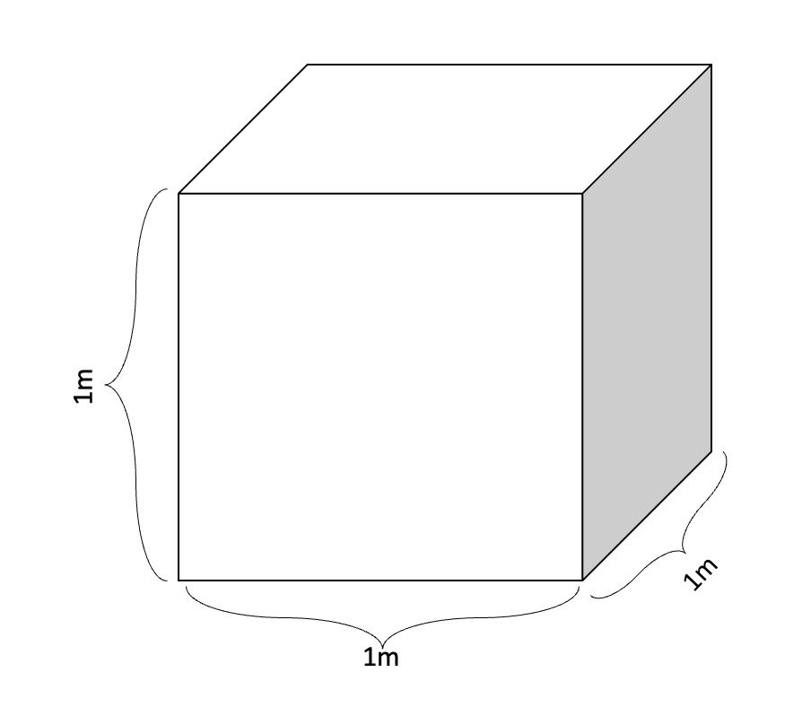
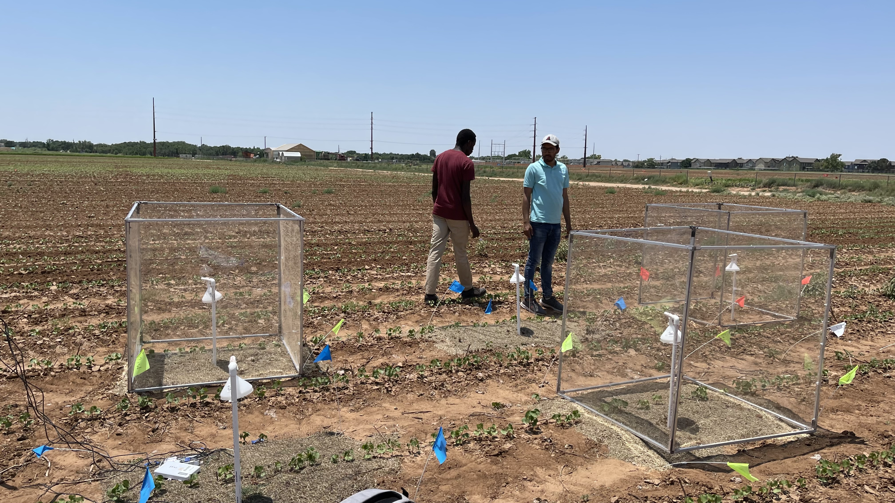
Warming setup

Slide 20
Irrigation:
Method: Sub surface drip irrigation
Amount: 218 mm of irrigation
337 mm rainfall
Residue:
3 kg/m2
Multispecies grass residue

Slide 21
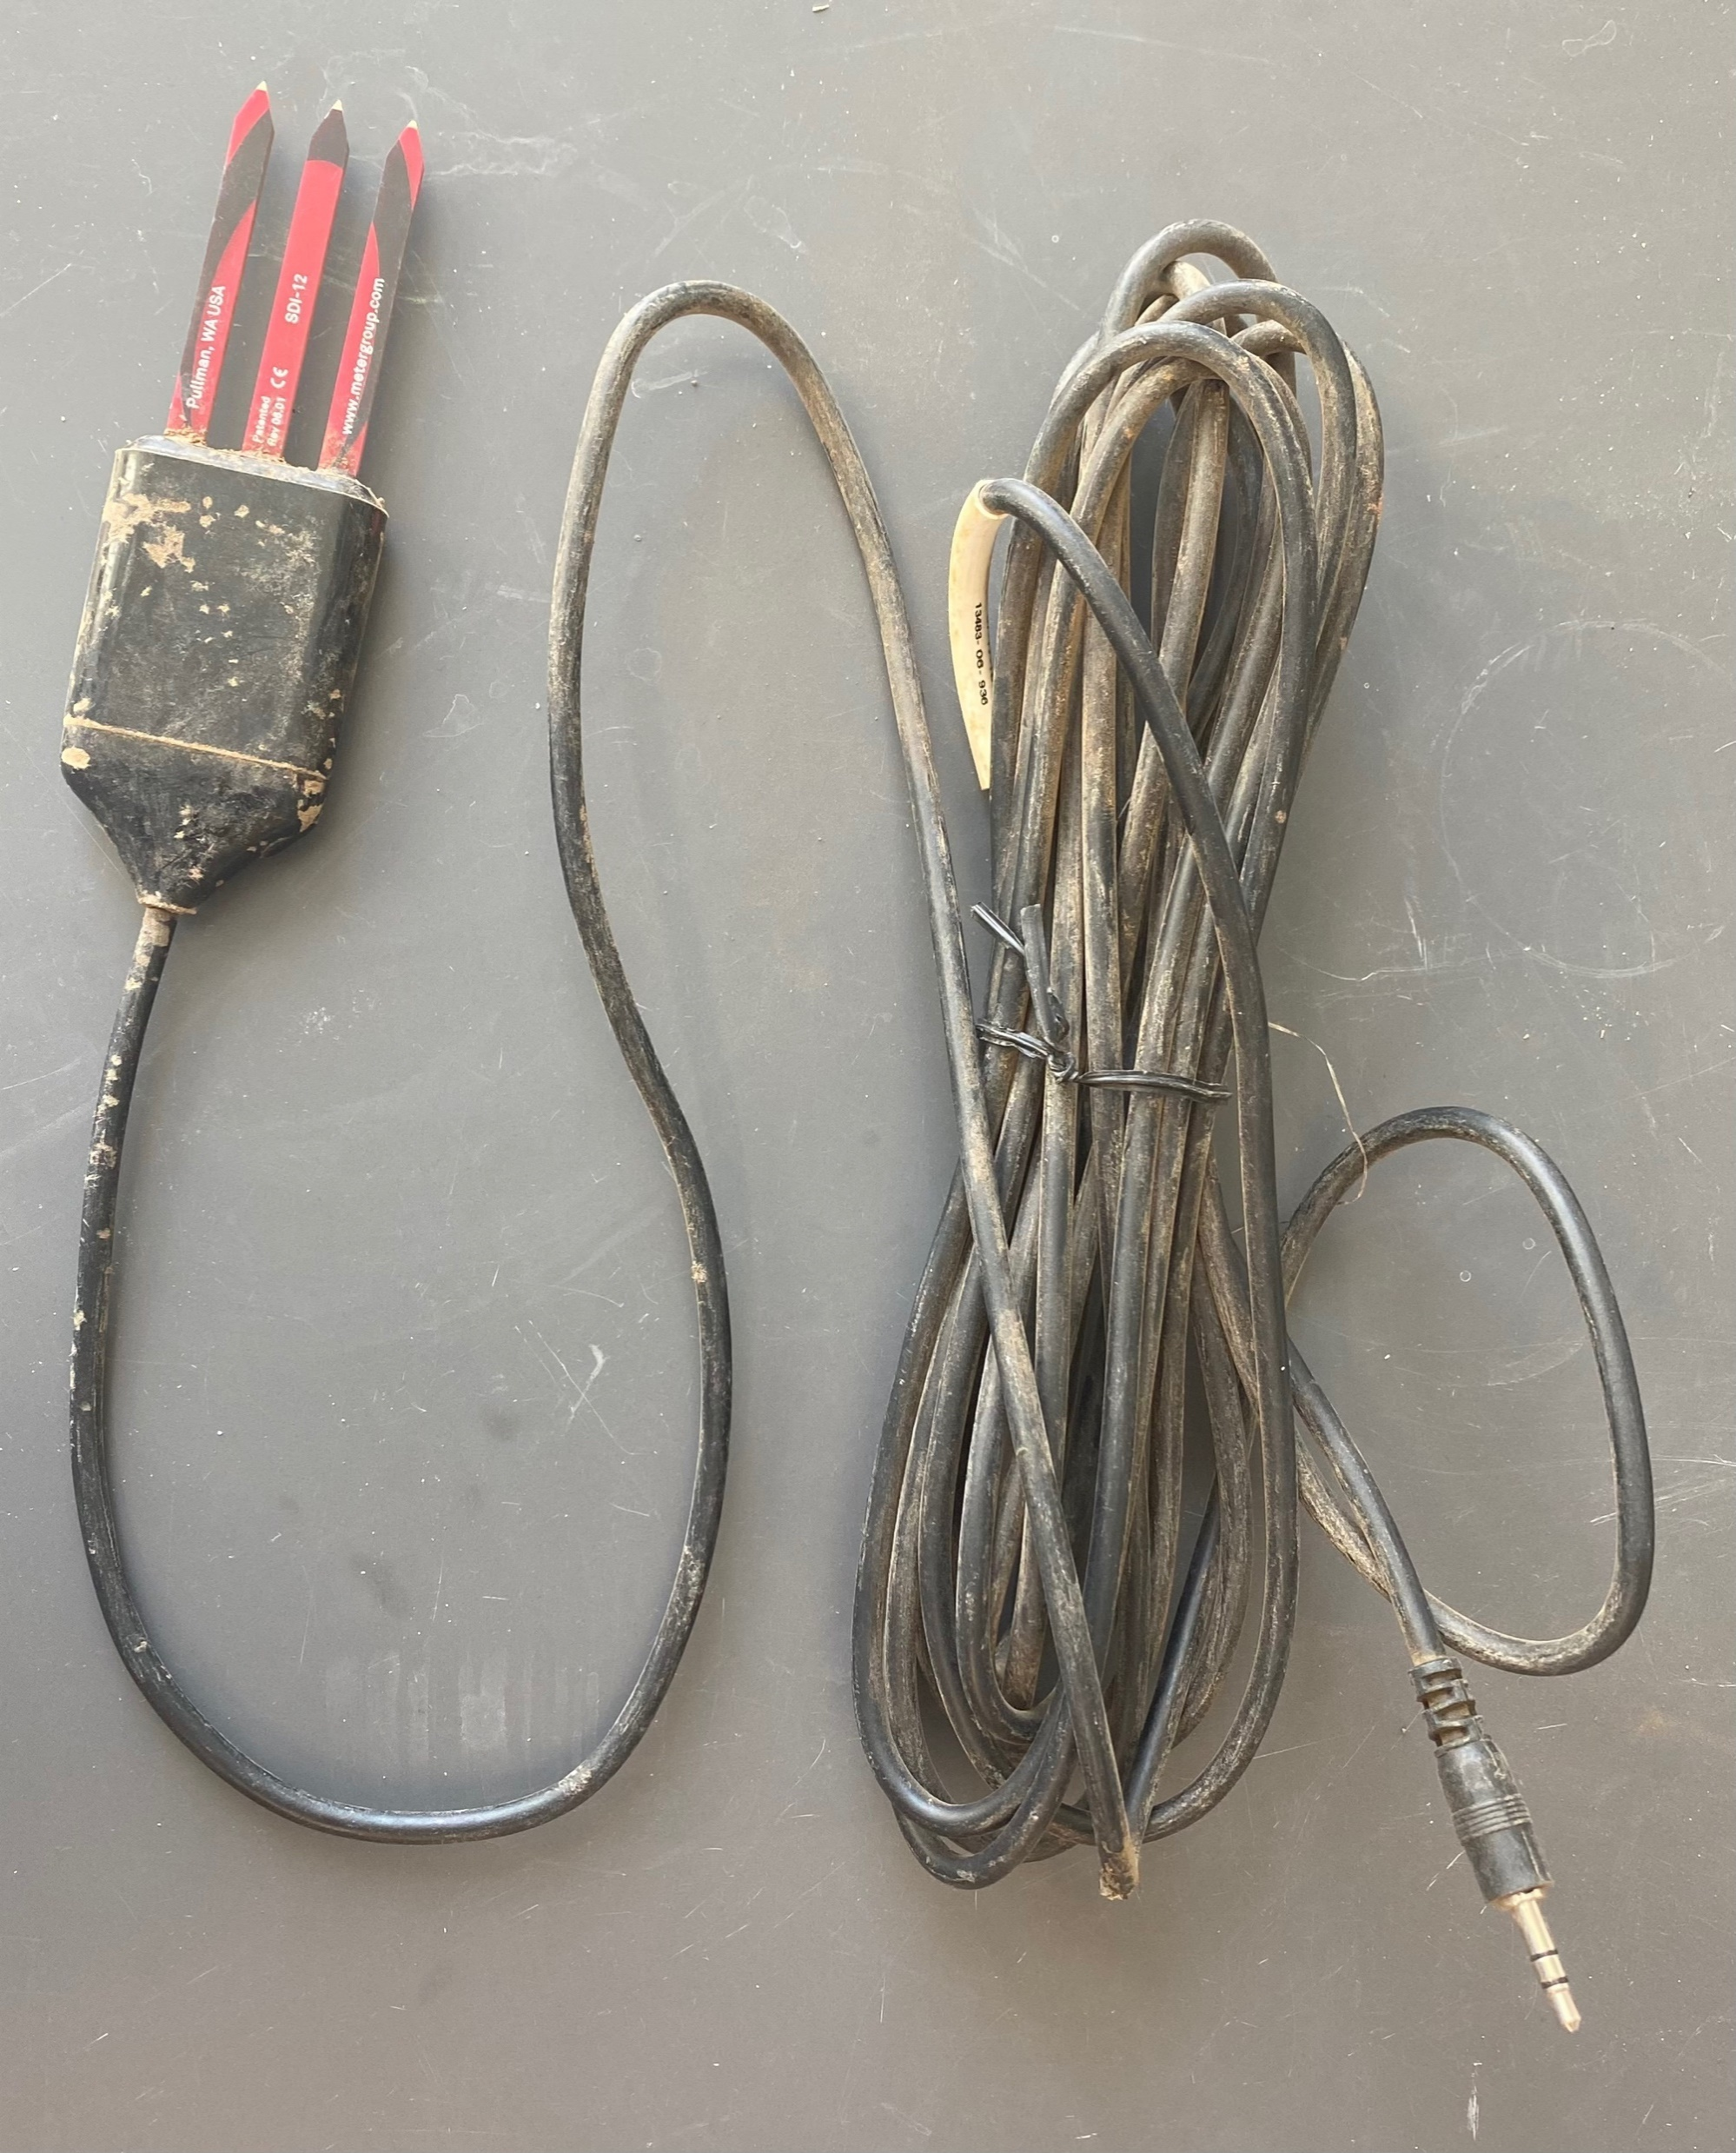

Temperature and moisture measurement

Slide 22

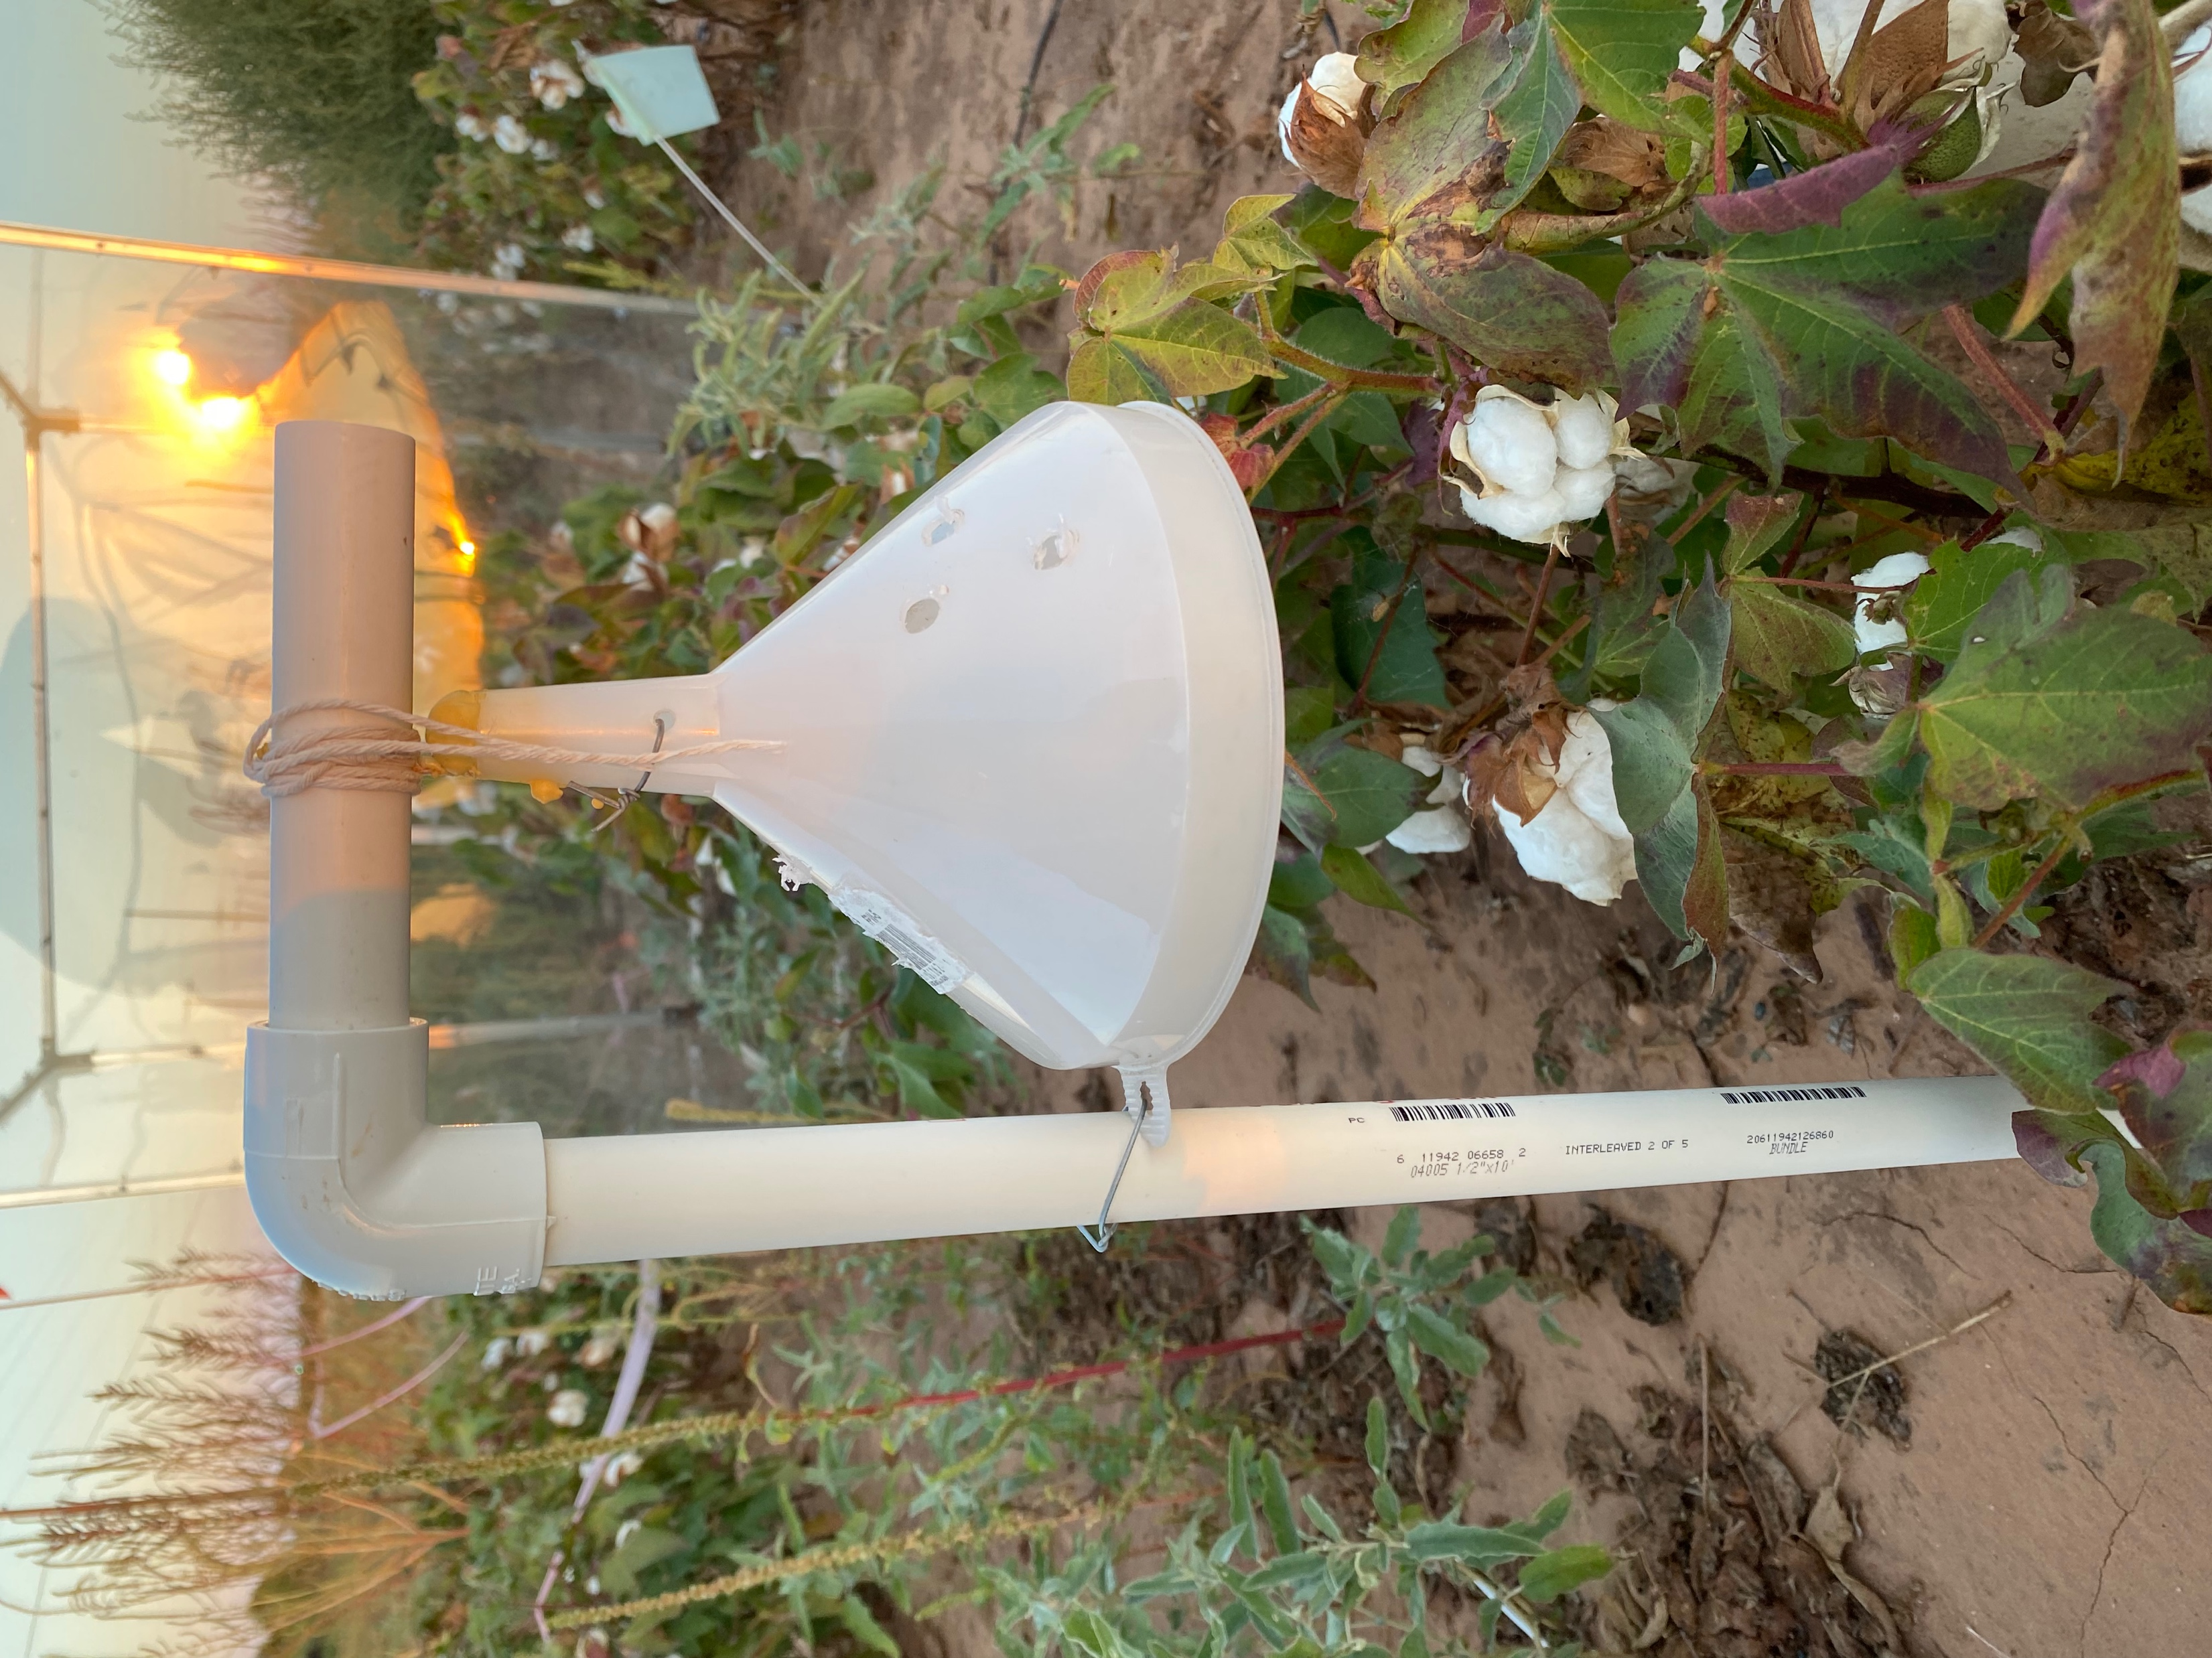
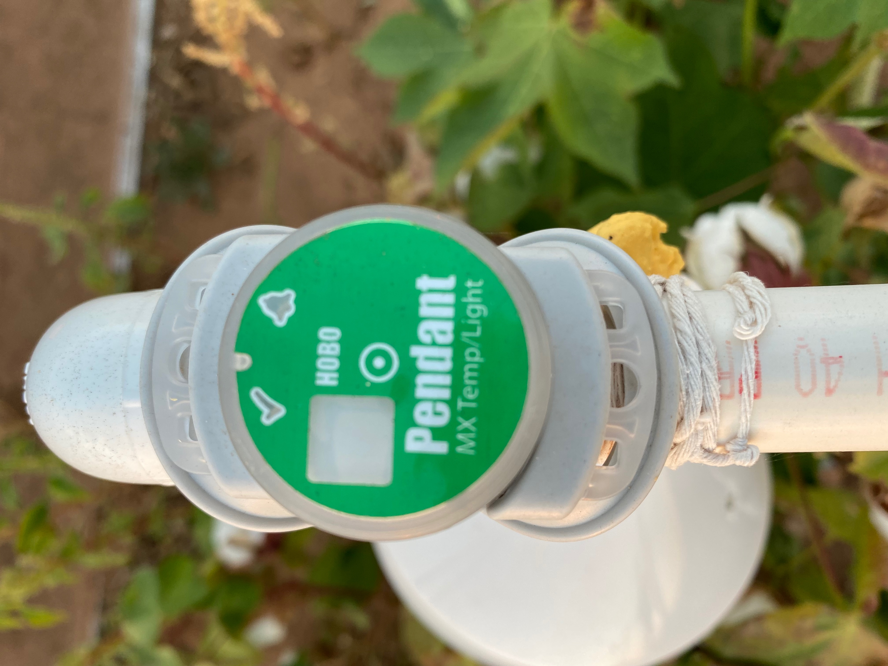
Temperature and moisture measurement

Slide 23
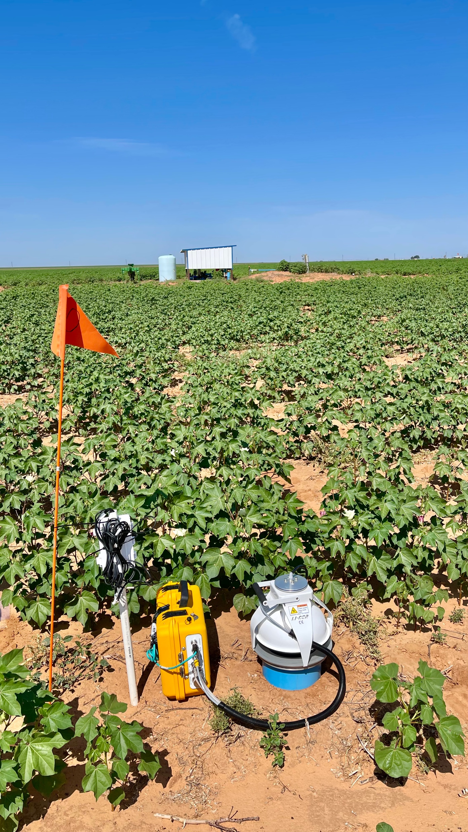
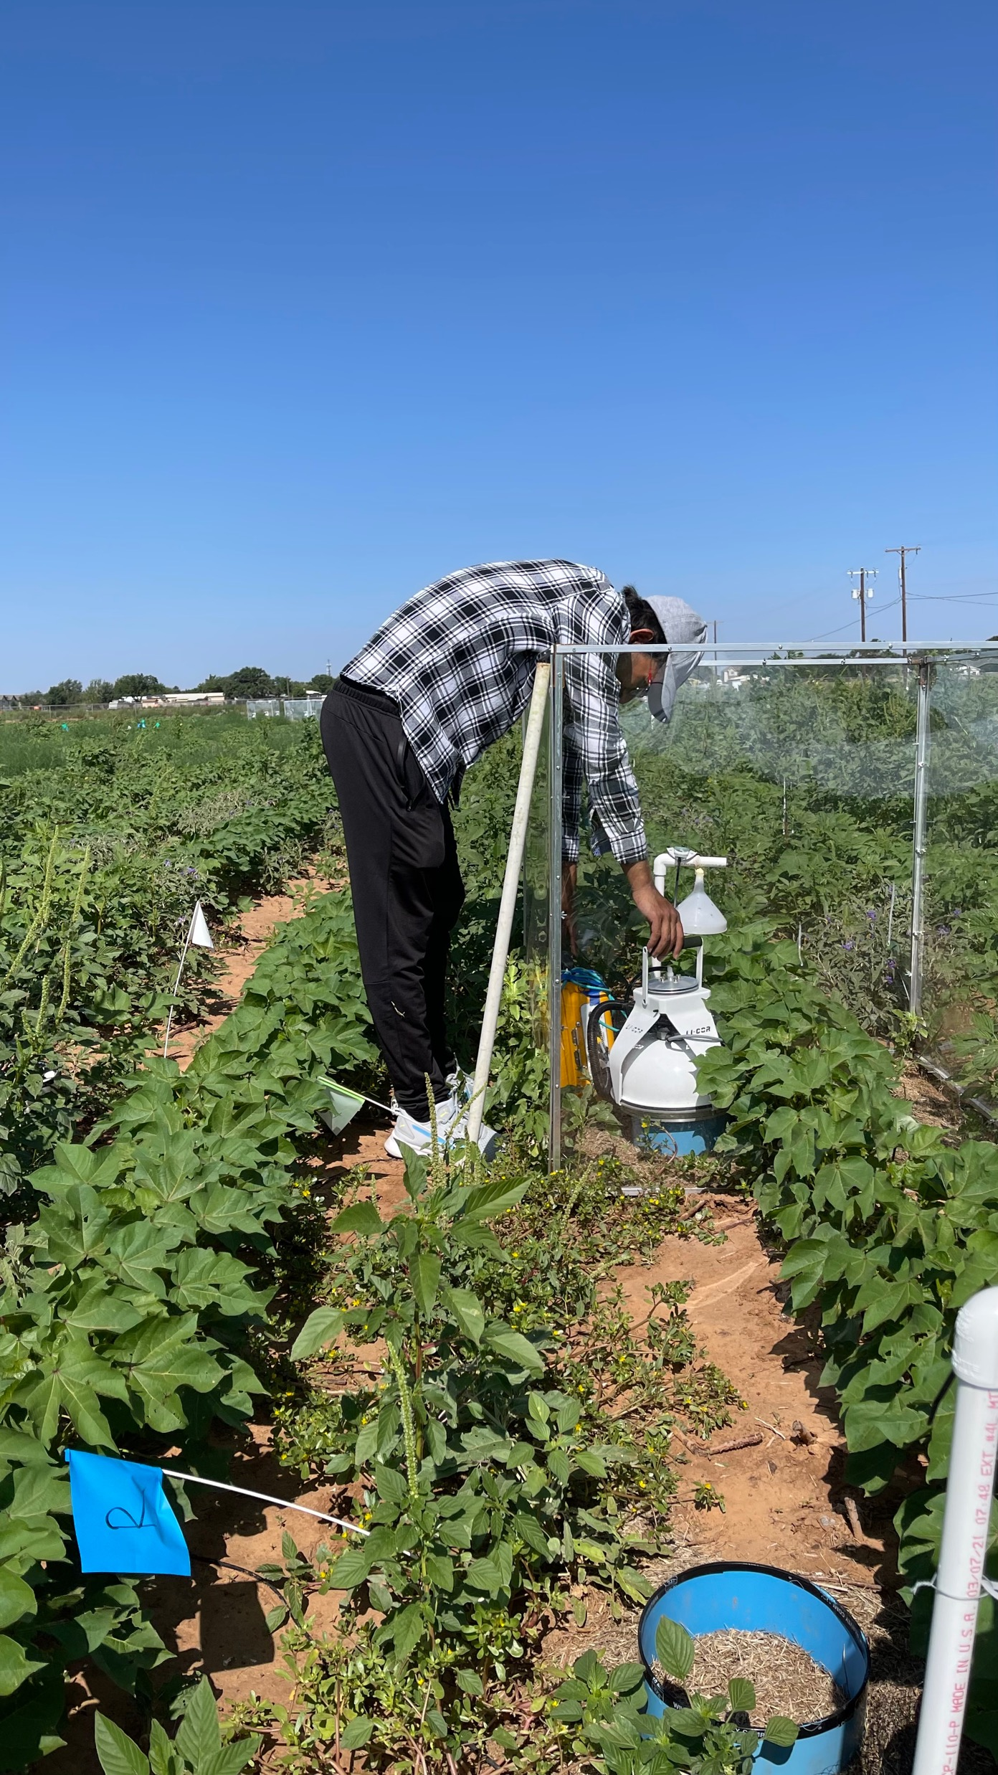
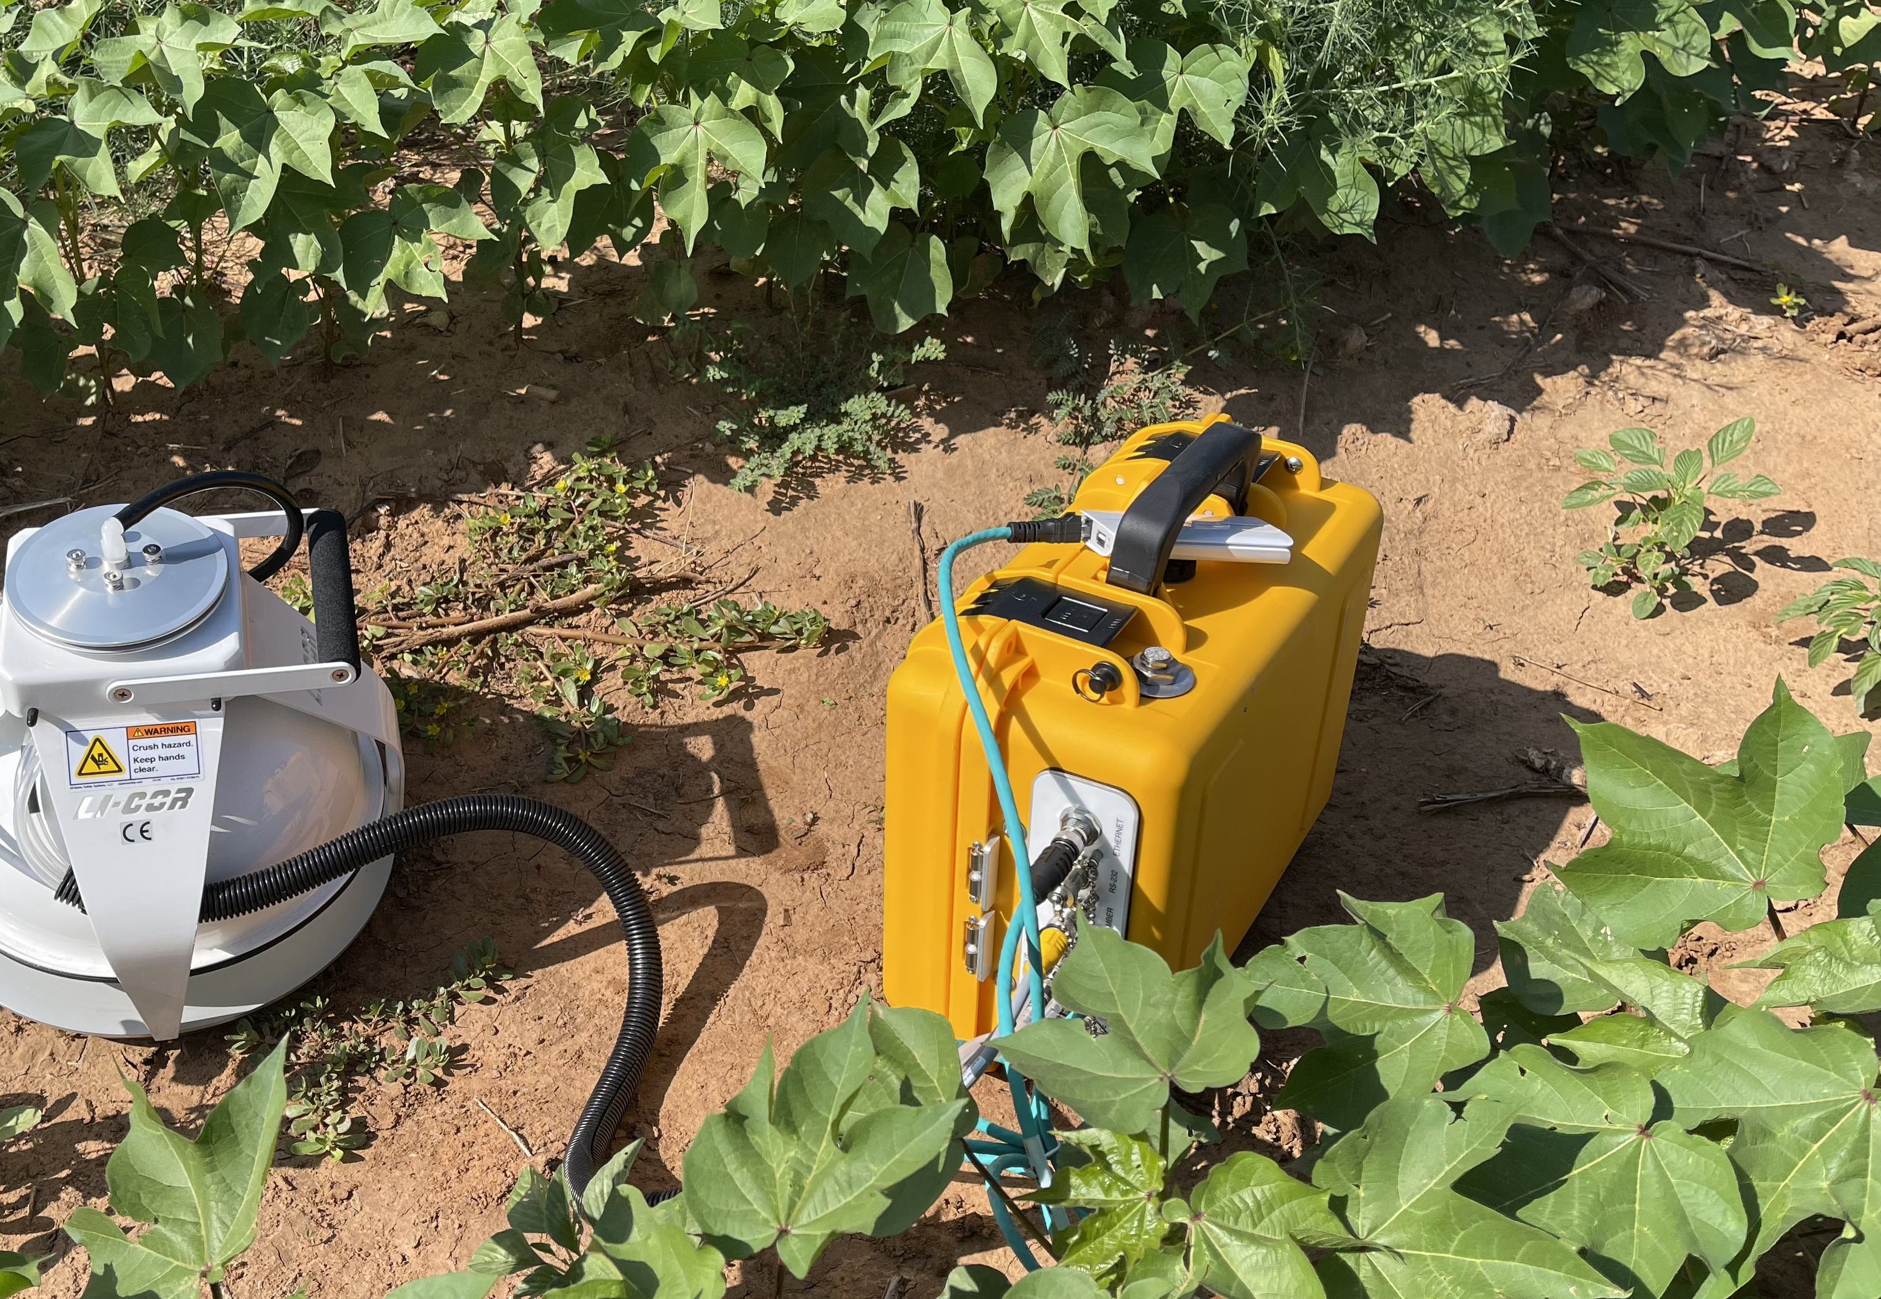
Soil Respiration measurement

Slide 24
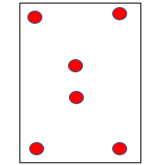
Soil Sampling
Soil Sample Collection:
Two soil samples collected from a subplot after the crop harvest in late October.
Lab analysis:
Nutrients & OM: Waters Ag. Lab.
MBC : Chloroform fumigation extraction technique (Vance et al., 1987)

Slide 25

Statistical analysis
Linear mixed effect models
Nested random effect (1 | block/plots)
Crossed random effects for time series data (1 | block/plot + 1| time)
Software: MS Excel, R
R Packages used:
tidyverse, lme4, lmerTest, emmeans, effects, ggplot2, sjplots

Slide 26
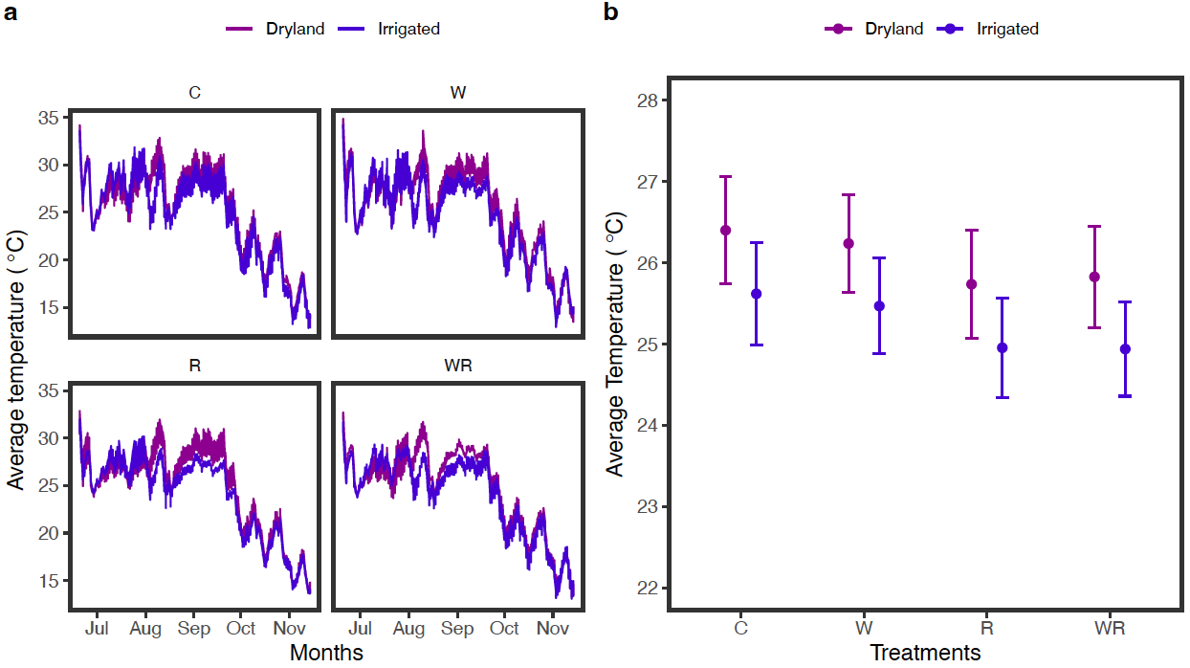
Soil temperature was higher in dryland

Slide 27
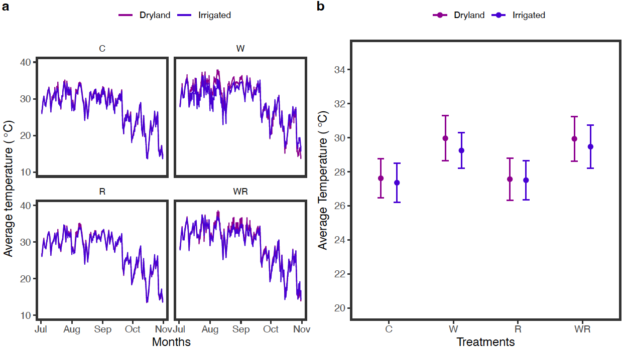
OTC increased air temperature by ~ 2.1 ⁰C

Slide 28
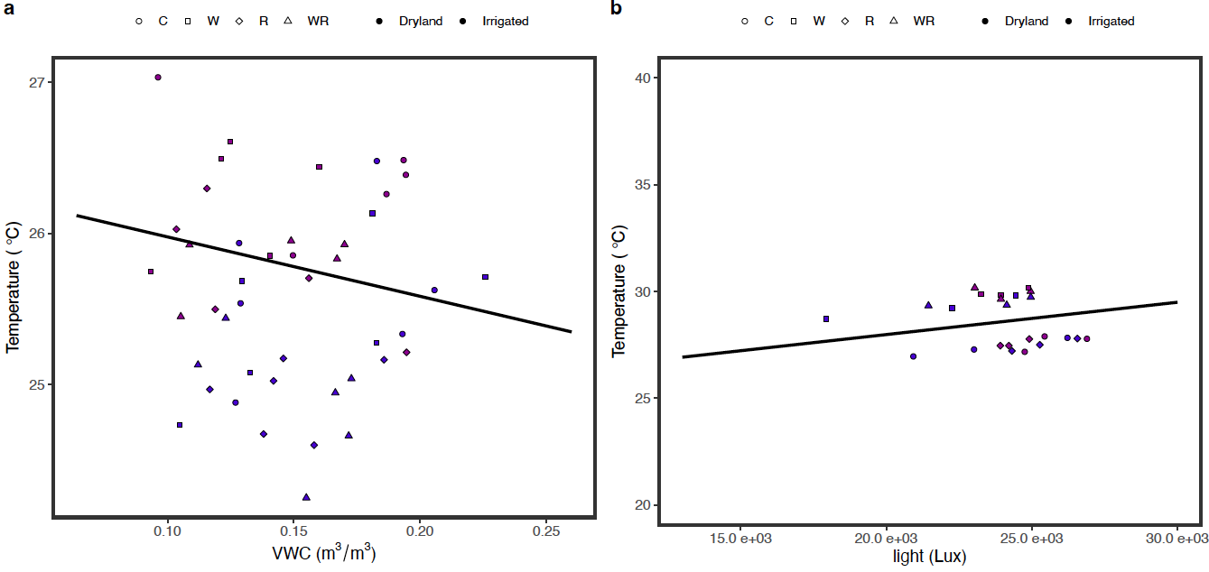
Soil moisture decreased soil temperature while light intensity has a positive effect

Slide 29
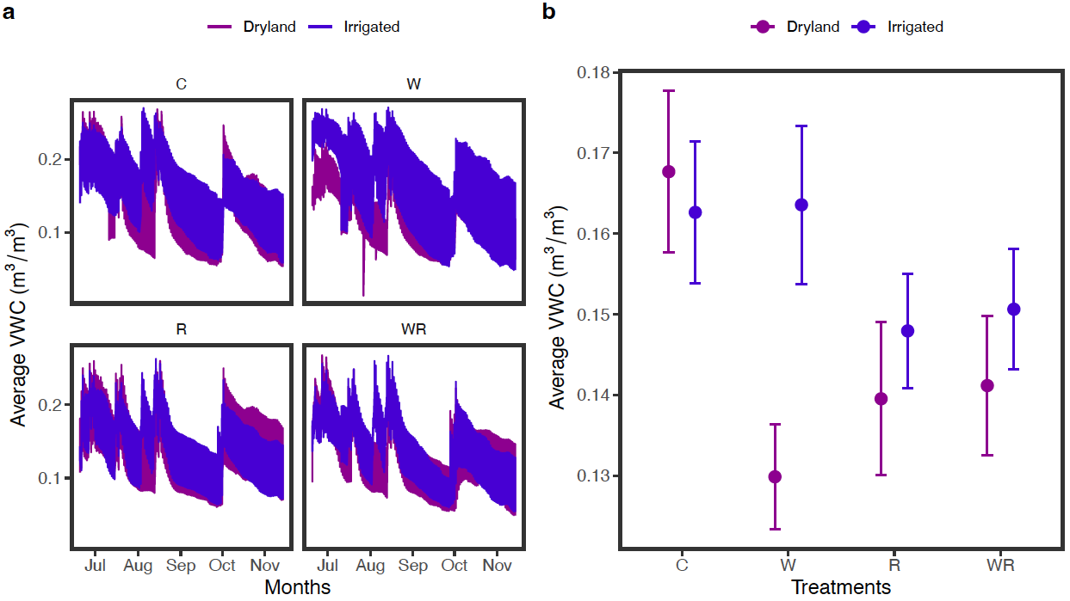
Warming reduced soil moisture

Slide 30
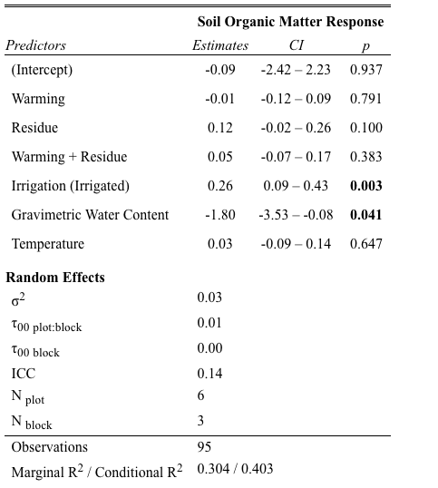
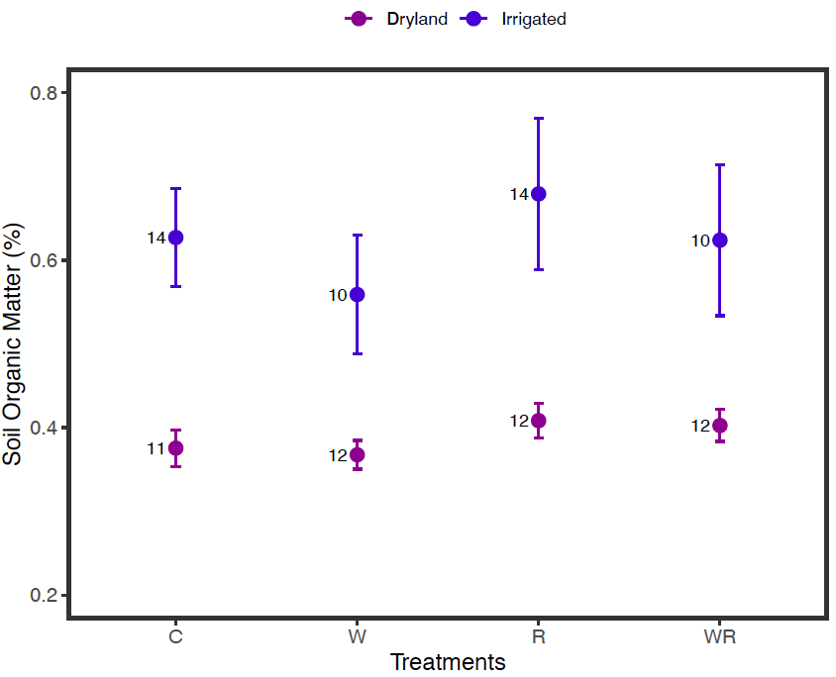
SOM was higher in irrigated field

Slide 31
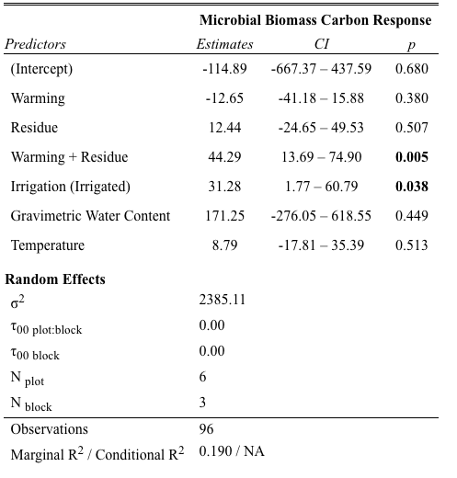
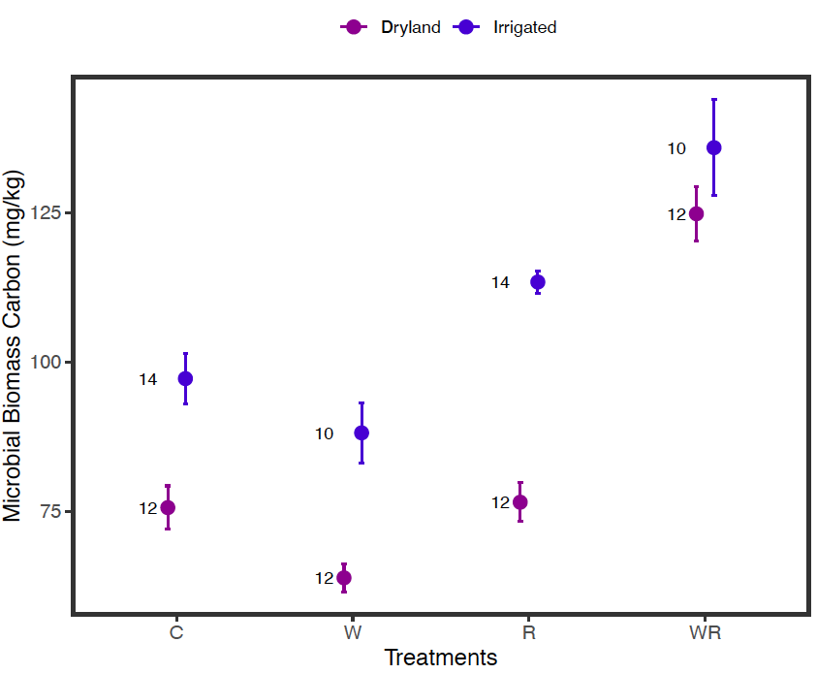
Irrigation and residue increased MBC

Slide 32
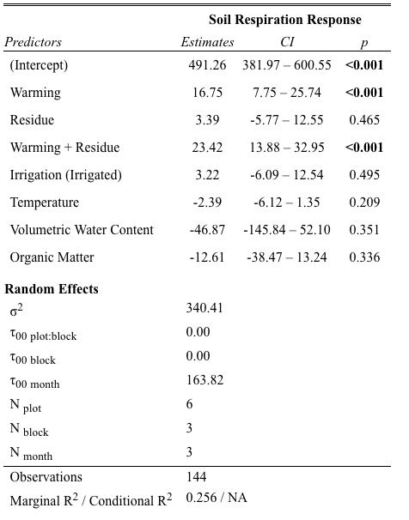
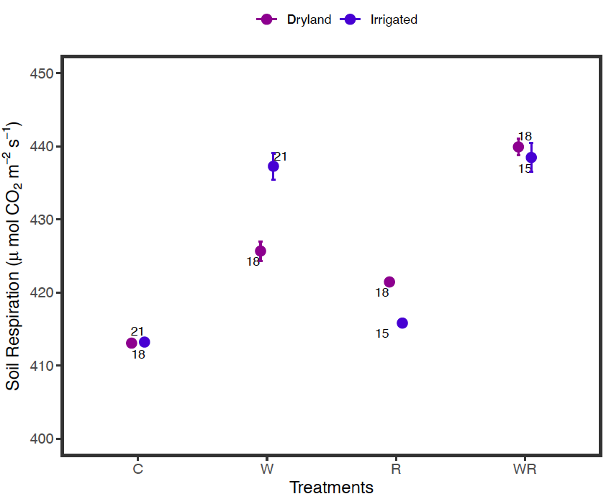
Soil respiration increased under warming

Slide 33
Summary
OTC increased air temperature by 2.1 ⁰C but did not significantly change soil temperature.
Soil moisture and temperature were negatively corelated. Therefore, increased temperature decreased soil moisture content.
Soil organic carbon (both OM & MBC) was higher under irrigation treatment
Residue significantly increased MBC
Soil lost greater amount of carbon through soil respiration under warming

Slide 34
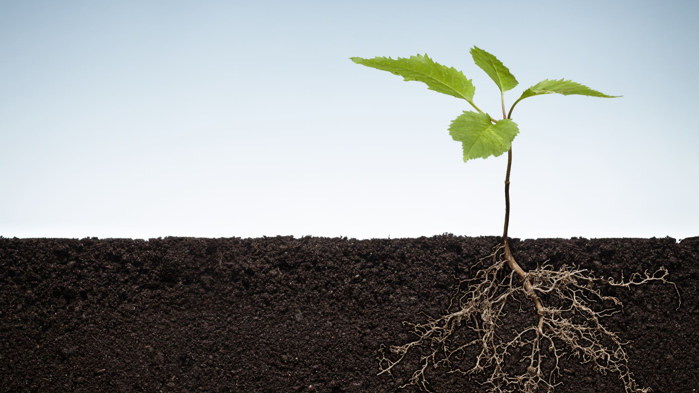
Chapter 2 Cotton Production under Experimental Warming

Slide 35
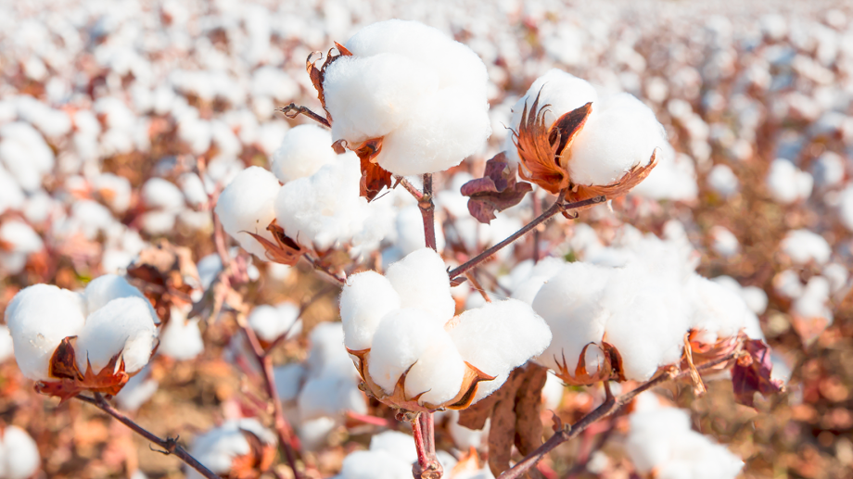
Cotton production In US
Great plain region
30-35 % of US cotton production or 5-8 % of world’s cotton production. (USDA NASS, 2020)
Declining
upland cotton production in Texas reduced by 8% in 2019 than 2018
Why?
Wet and mild weather during planting season in May, as well as hot and dry conditions during the critical growth phase in August

Slide 36
Role of Climate in Crop Production
Temperature and precipitation contribute for 30% or more of the fluctuation crop yield (Lobell & Field 2007)
Regions that are already on the edge of temperature or precipitation limit for cultivation are most sensitive
In US,
The Great Plains region: most susceptible to changes in precipitation
Northwestern and north-central states: most sensitive to changes in temperature (Ramankutty et al., 2002)

Slide 37
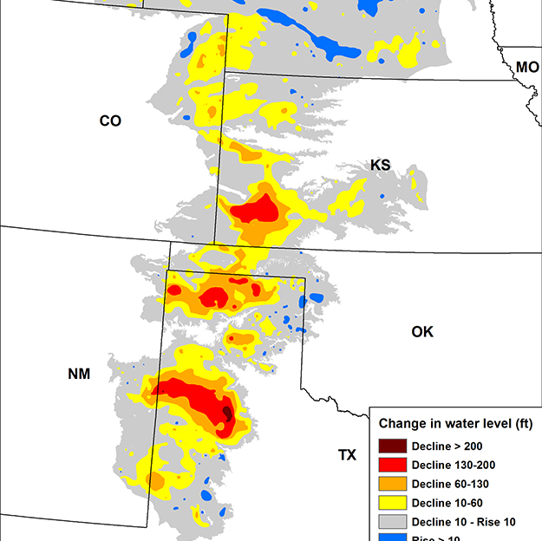
Moisture stress in Texas High Plains
Semi arid climate
Dependent on irrigation water
60% of Agricultural field in Texas high plain is irrigated (Brett, 2013)
Source:
Groundwater (Ogalala aquifer)

Slide 38
Heat stress
CO₂ Fertilization
Warming
Impede Reproductive growth
Moisture stress
Shortens crop cycle

Slide 39
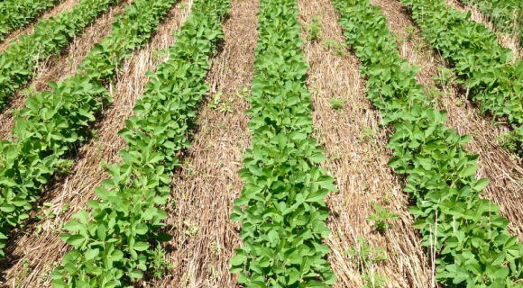
Mitigation
Soil moisture conservation
SOM
Residue
No tillage
Crop rotation
Cover cropping
Irrigation

Slide 40
Objectives
to investigate the effects of warming on cotton biomass production and yield
to study how irrigation and residue application changes the warming impacts.

Slide 41
Warming
Irrigated
Dryland
Residue
No residue
Residue
No residue
Plant biomass
Plant biomass
Yield
Yield

Slide 42
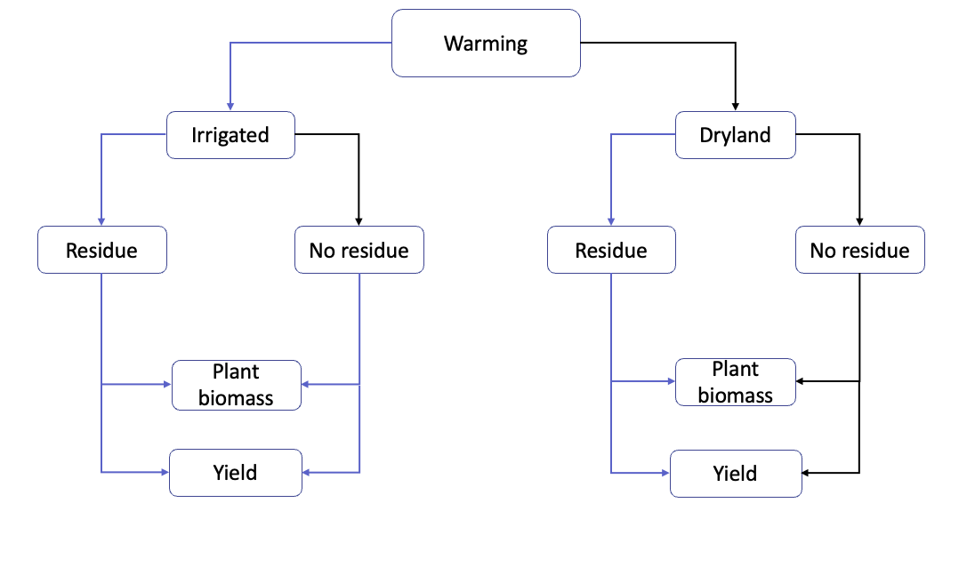
Hypothesis

Slide 43
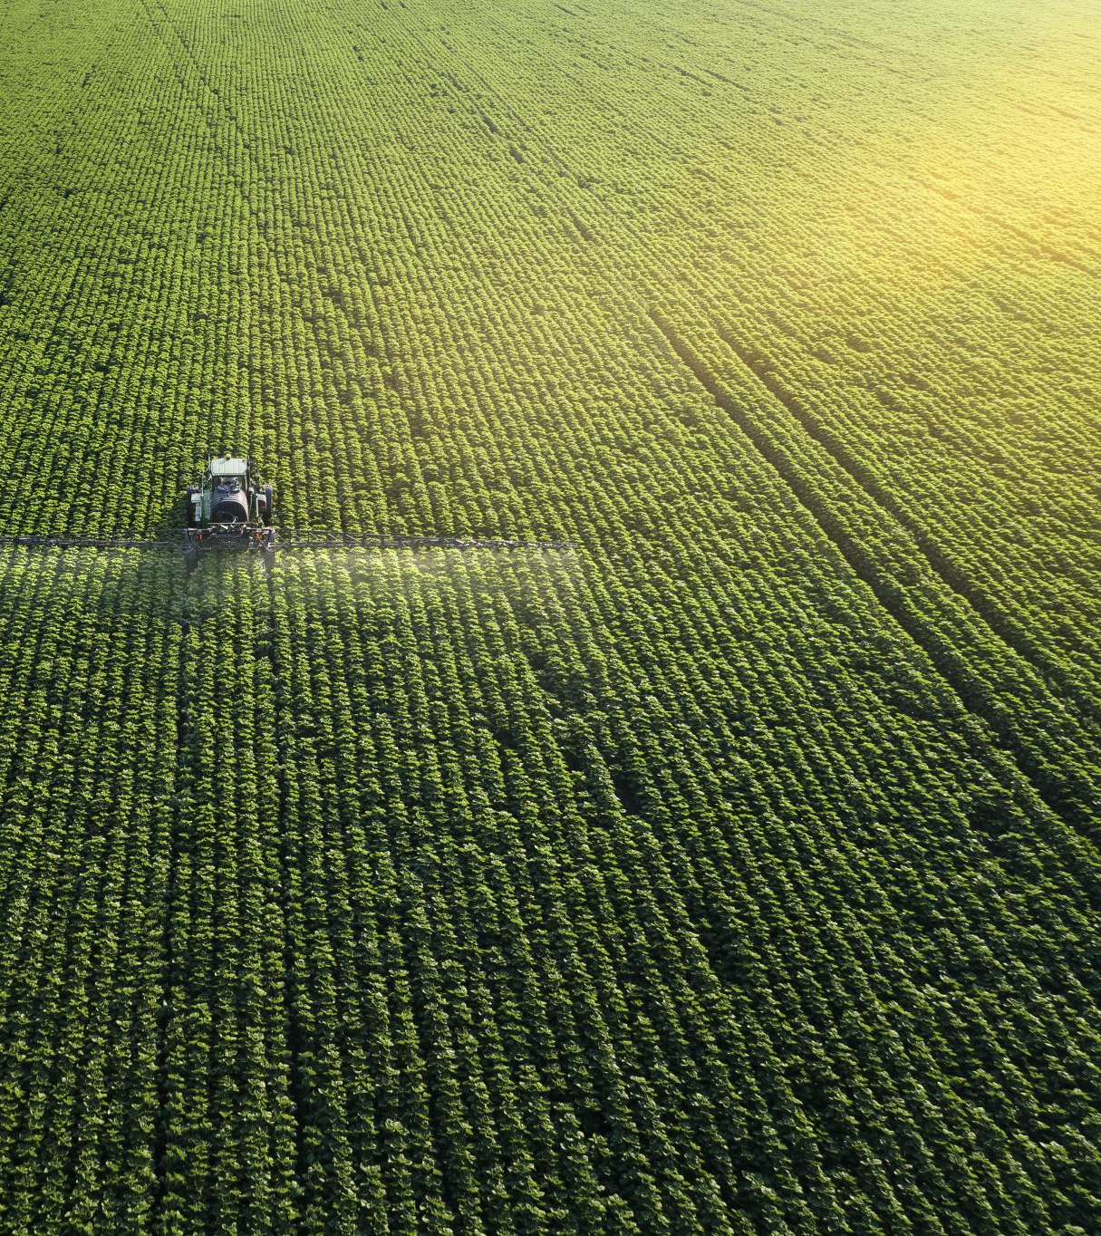
Cotton Cultivation
Finely tilled using the disc plow
Cotton was planted continuously in rows spaced 1 meter apart.
Residue: multispecies grass @3 kg/m2
Weeding: Hand weeding
Irrigation: 218 mm during growing season

Slide 44
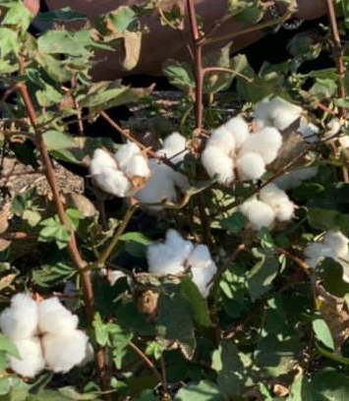
Harvesting
Late October > 90% bolls fully opened
Manual harvesting by hand picking & using pruner
Air dried for 2 weeks
Data recorded
Number of bolls per plant
Aboveground biomss
Belowground biomass
Seed cotton yield

Slide 45

Belowground Biomass Measurement
Soil cores (3 cm diameter, 10 cm length)
Sieved through 2mm mesh
Hand picked root samples and air dried before recoding weight

Slide 46
Statistical analysis
linear mixed effects model.
Block and plot as nested random effects.
lme4 package R

Slide 47
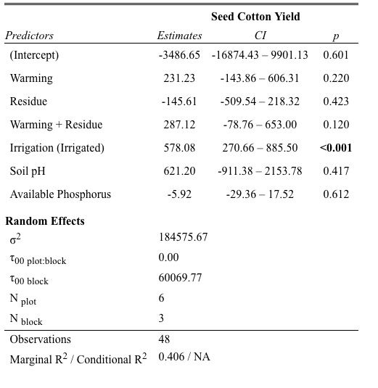
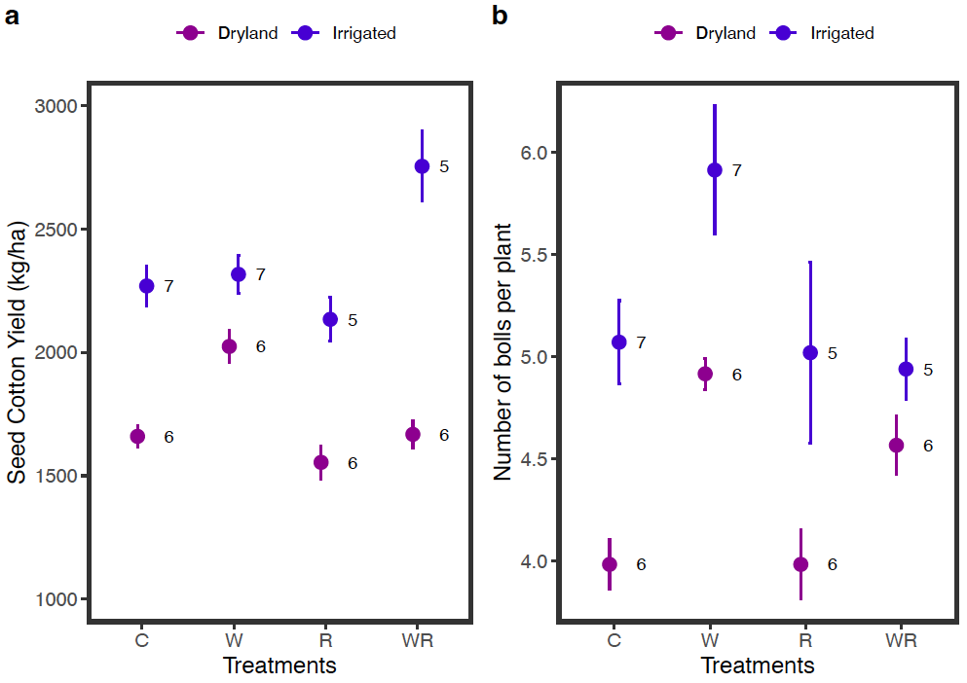
Irrigation increased seed cotton yield

Slide 48
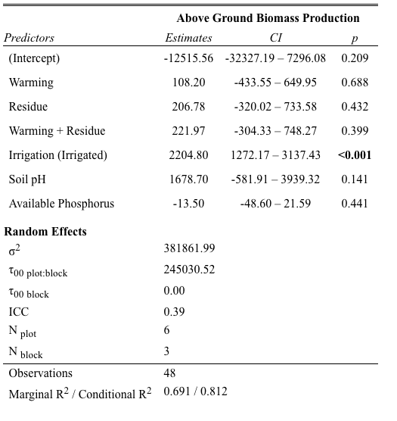
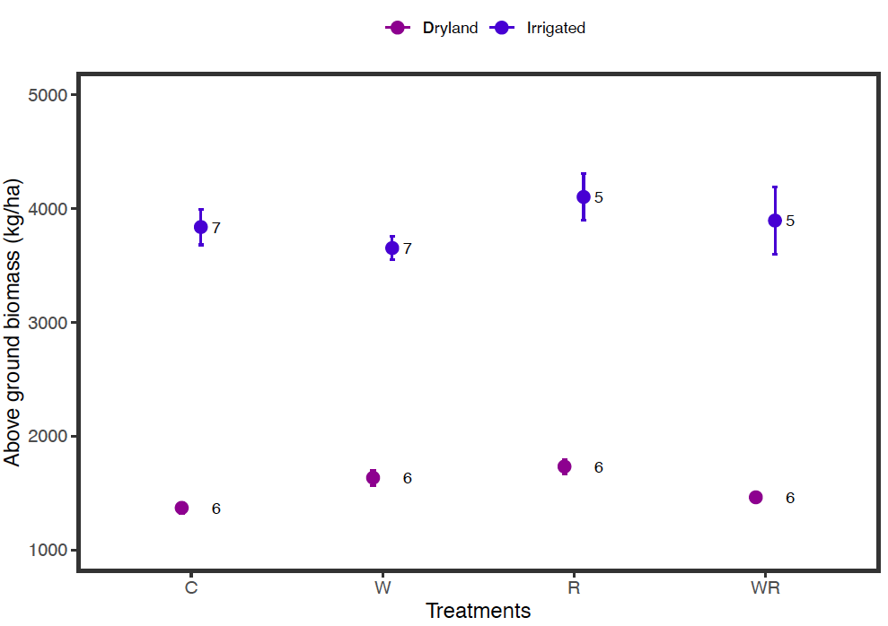
Irrigation increased above ground biomass

Slide 49
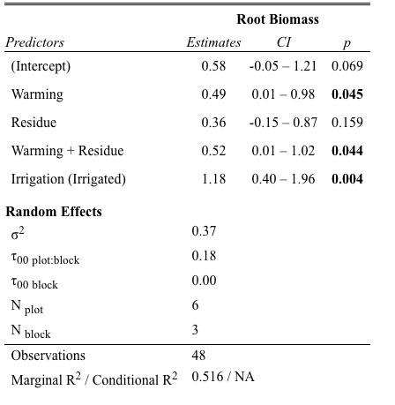
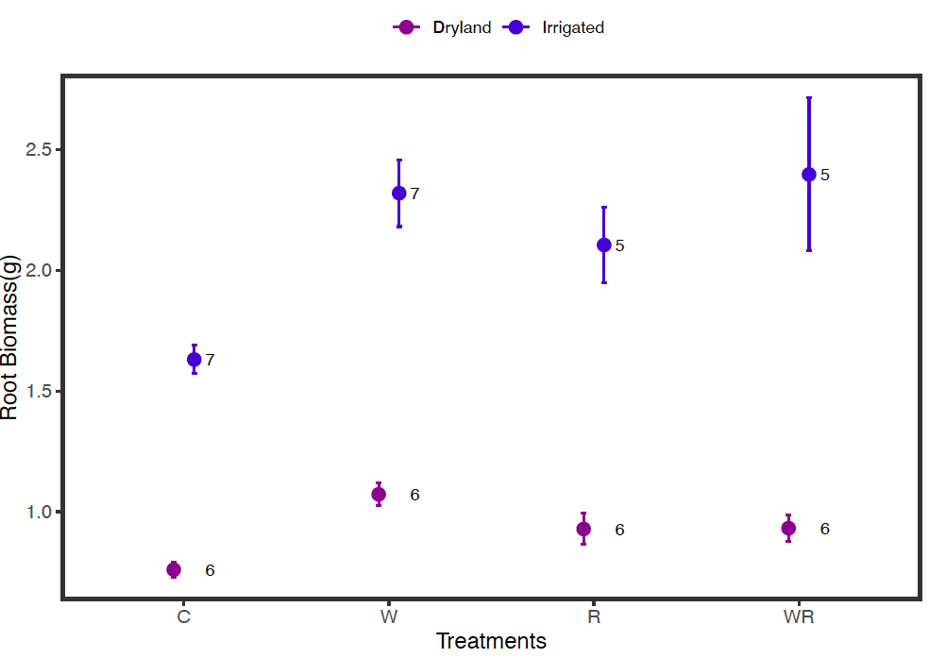
Irrigation increased root biomass

Slide 50
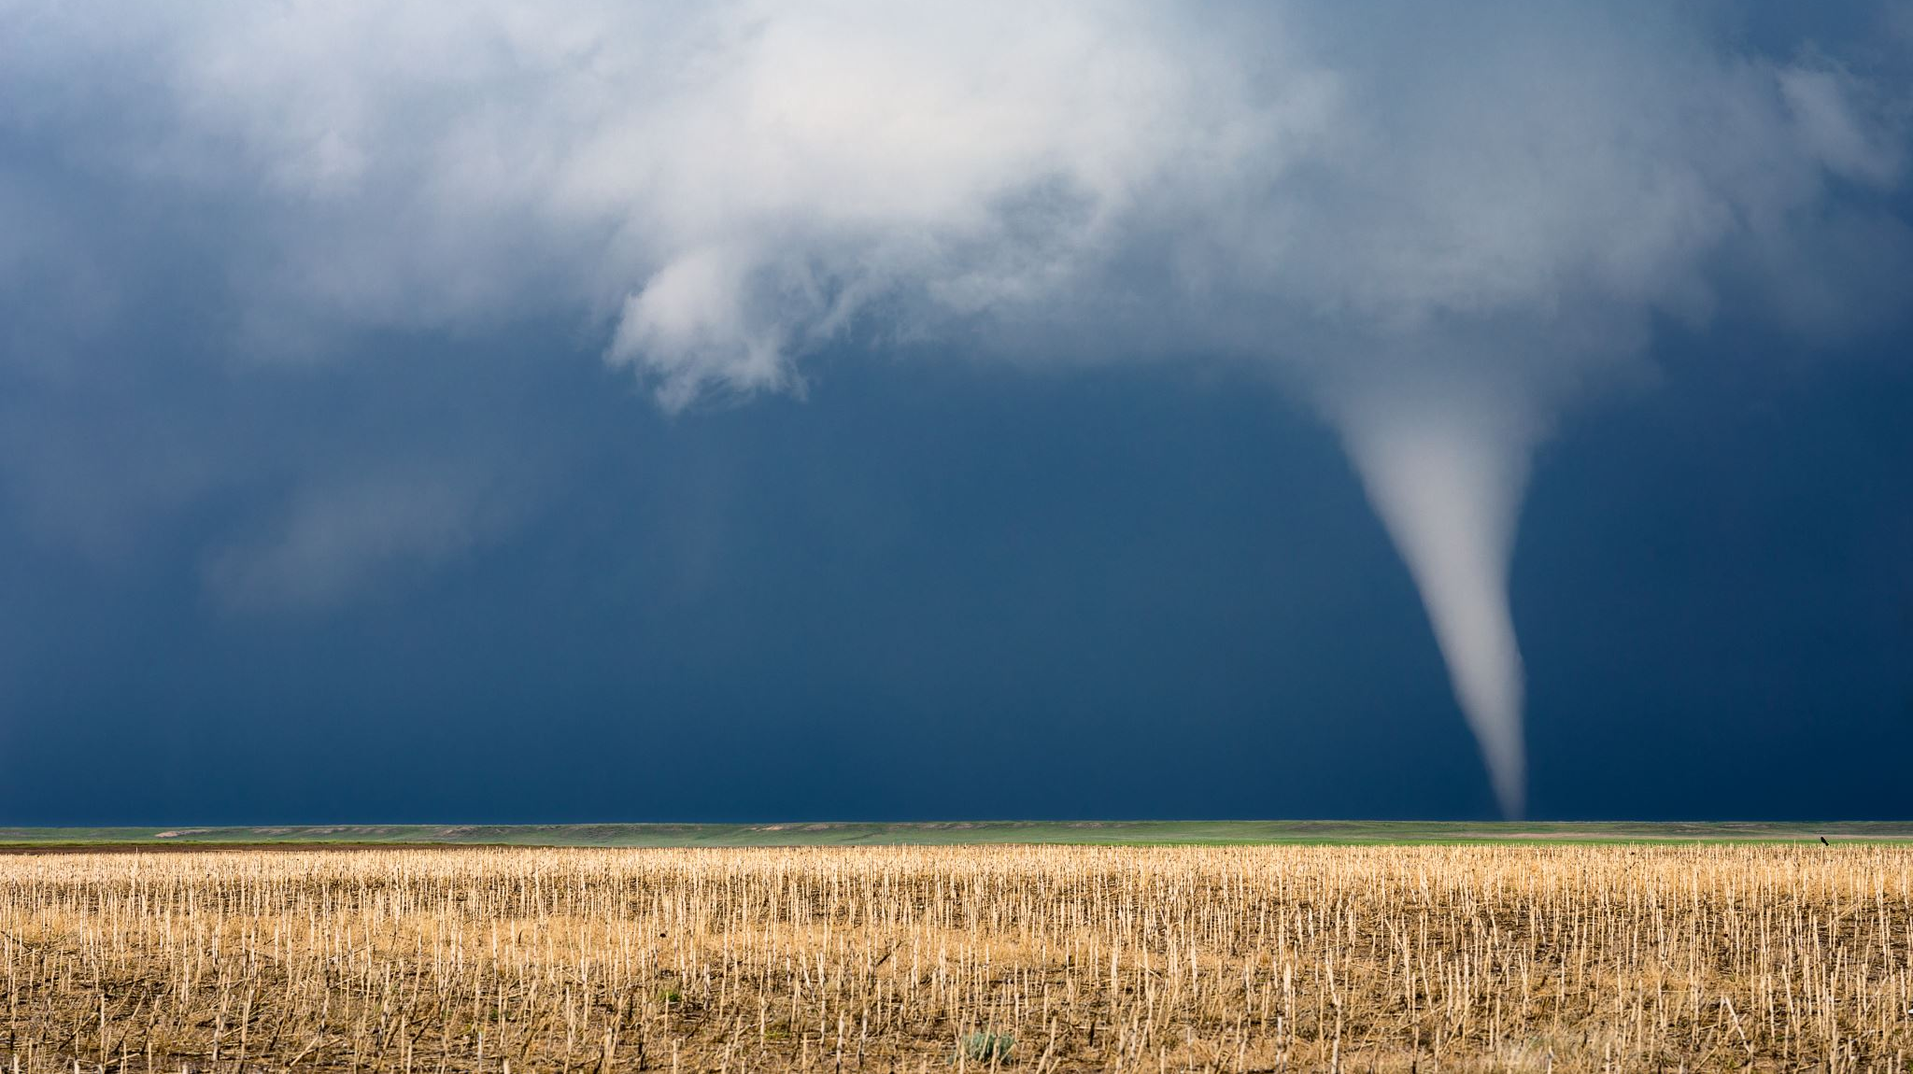
Conclusion
Irrigation increased both above ground, below ground biomass production, and cotton yield, while warming didn’t seem to have strong influence on cotton production
Greater root biomass yield was observed under climate warming.
Cotton growth and yield are more sensitive to moisture stress than heat stress.

Slide 51
Acknowledgement
Thank You!
Natasja van Gestel, PHD
Nick Smith, PHD
Lindsey Slaughter, PHD
Dylan Schwilk, PHD
Payton Paxton, PHD
Lelton Howell
Taiwo Osoko
Rakesh Singh

